Slide 1
Pacific Cup 2022
Galatea

Slide 2
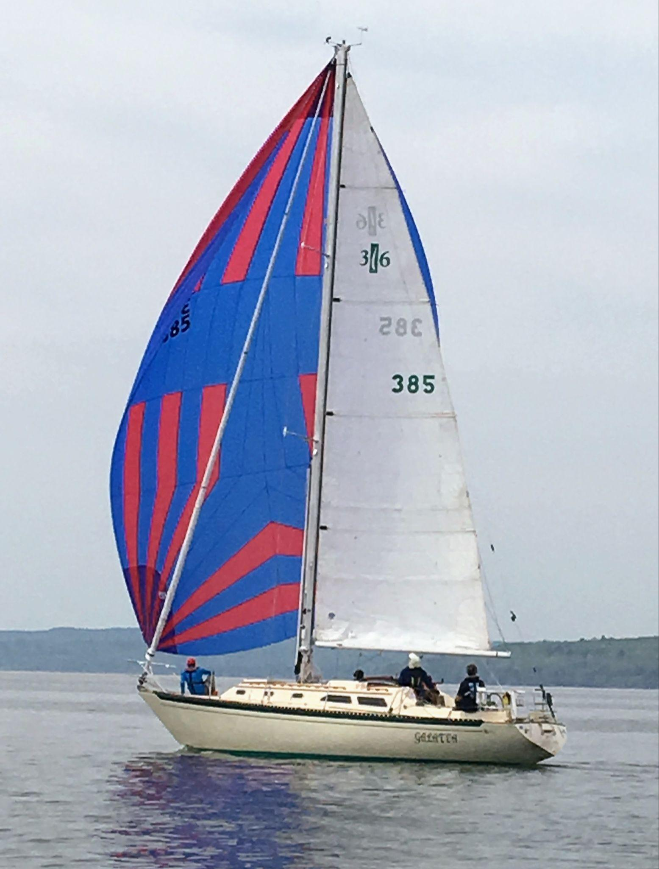
Galatea
1977 Islander 36
standard rig
What it took to prepare
What it was like on the water
Notes:
Eric: I could still respect you if you bought this boat
For AIYC: many production boats, e.g. “Eagle”

Slide 3
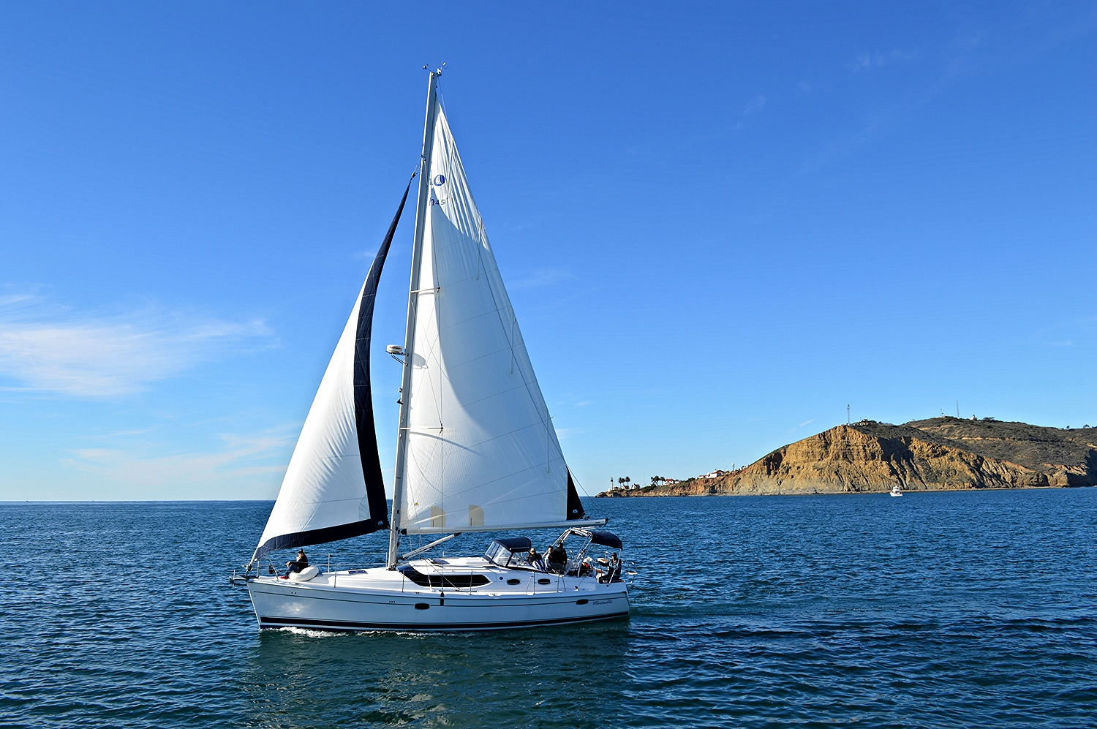
Origin of the idea to sail to Hawaii from CA
I started sailing in San Diego in the 70s
Ericson 35
Family boat
Cruised Southern CA
I wondered what’s over the horizon?
Can you sail to Hawaii from here?

Slide 4
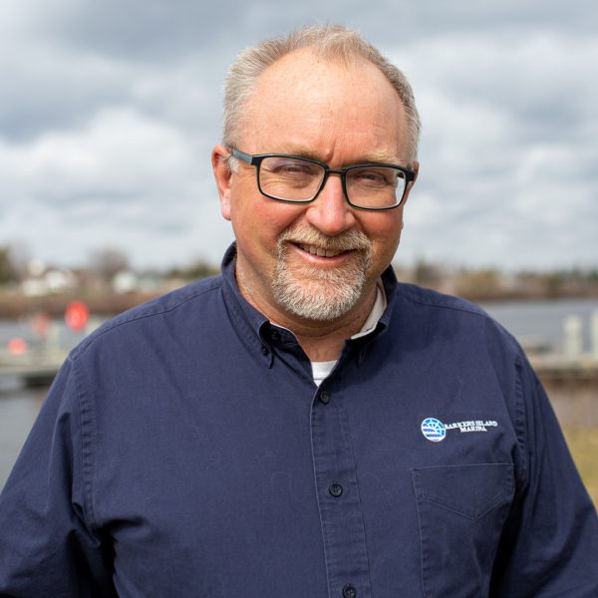
Necessary: Great Friends in the right places
Eric Thomas
Single Handed Transpac
Many offshore races
Experienced racer
Experienced boat fixer
Barker’s Island Marina
Great place to base a program to do big project such as Pacific Cup

Slide 5
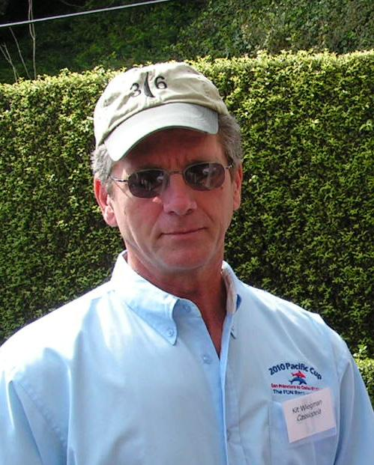
Necessary: Great mentors and examples
Kit Weigman
4 Pac Cups in I-36!
Lots of other experience

Slide 6
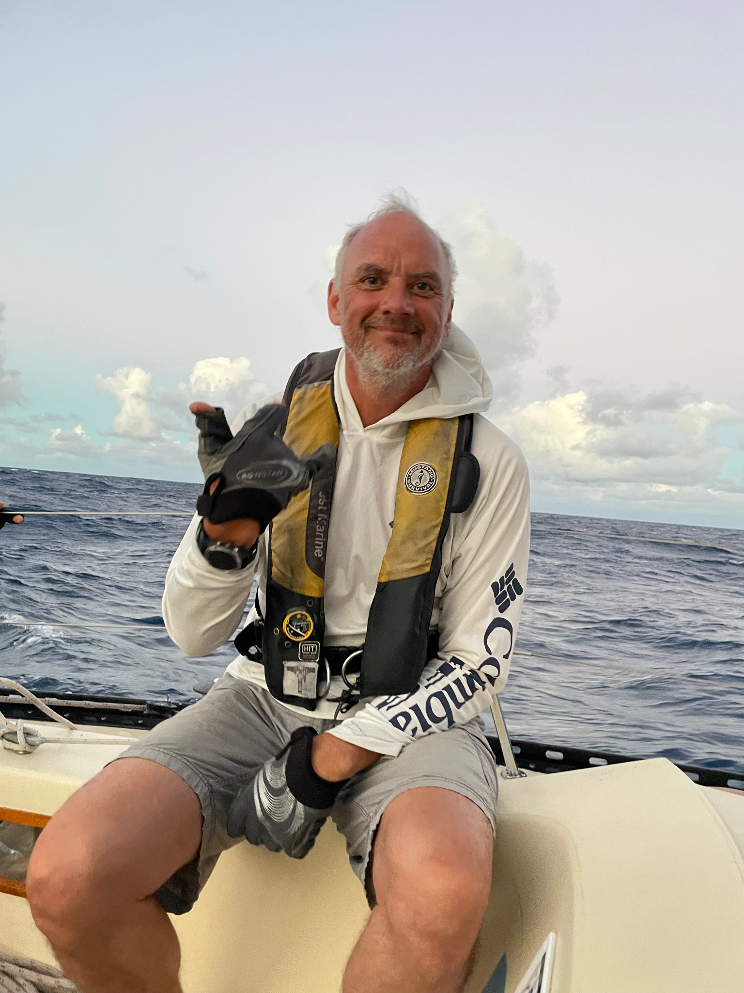
Necessary: Great crew
Pete Shelquist

Slide 7
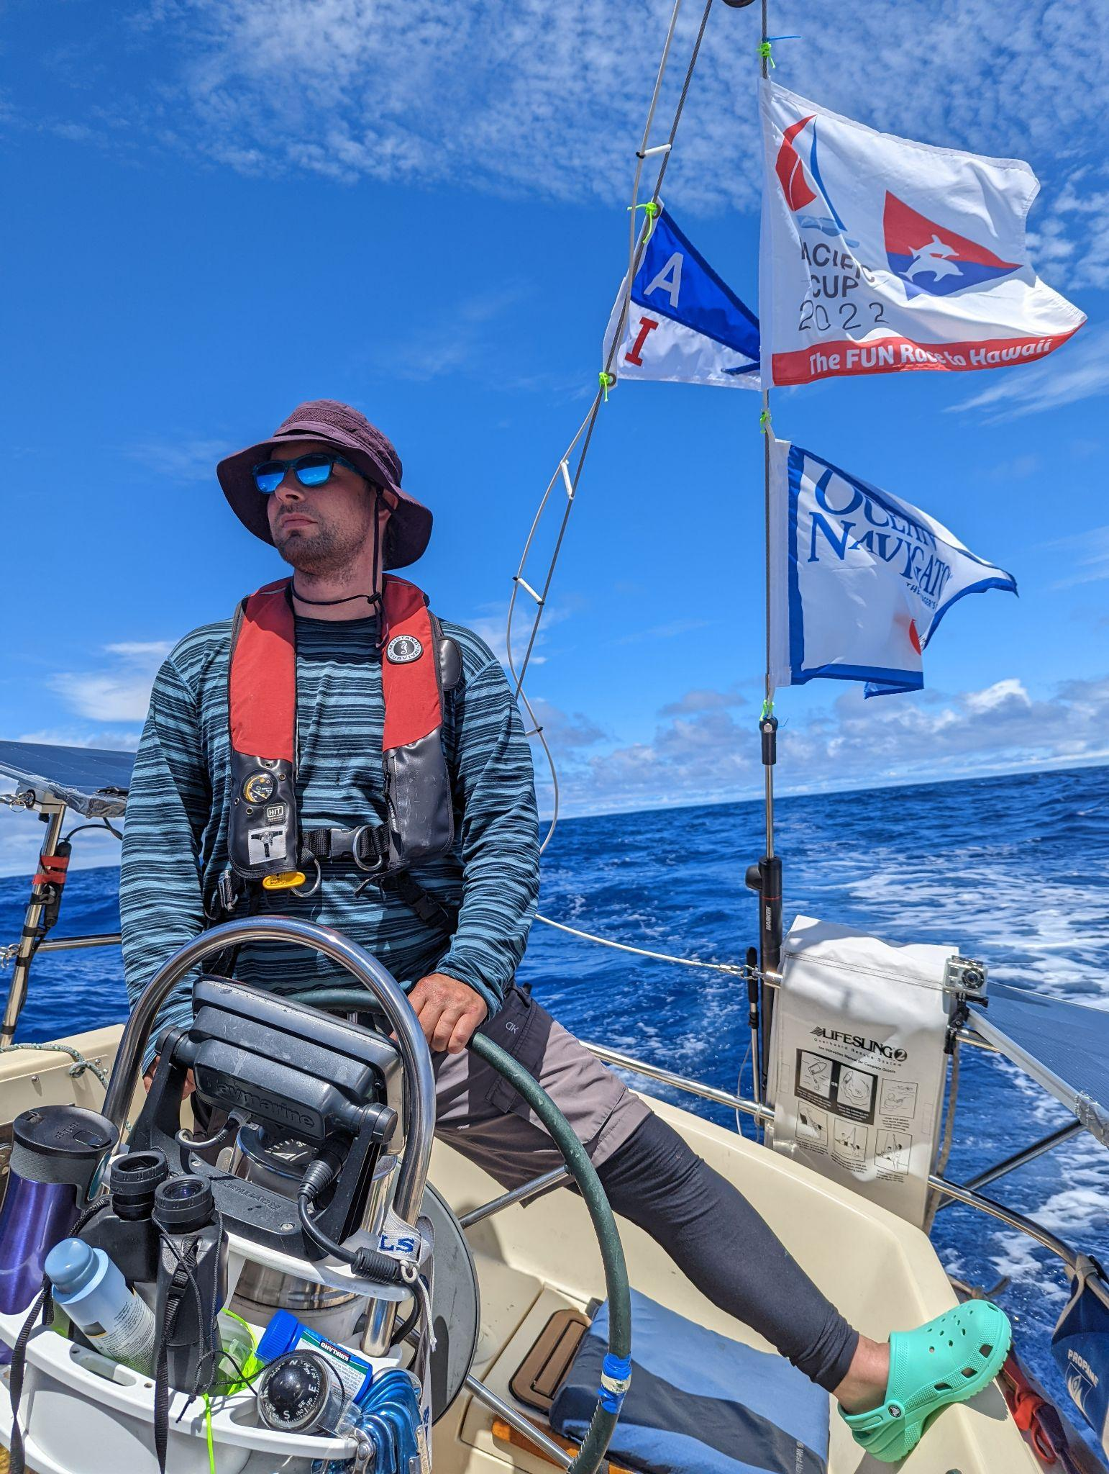
Necessary: Great crew
John Weissert

Slide 8
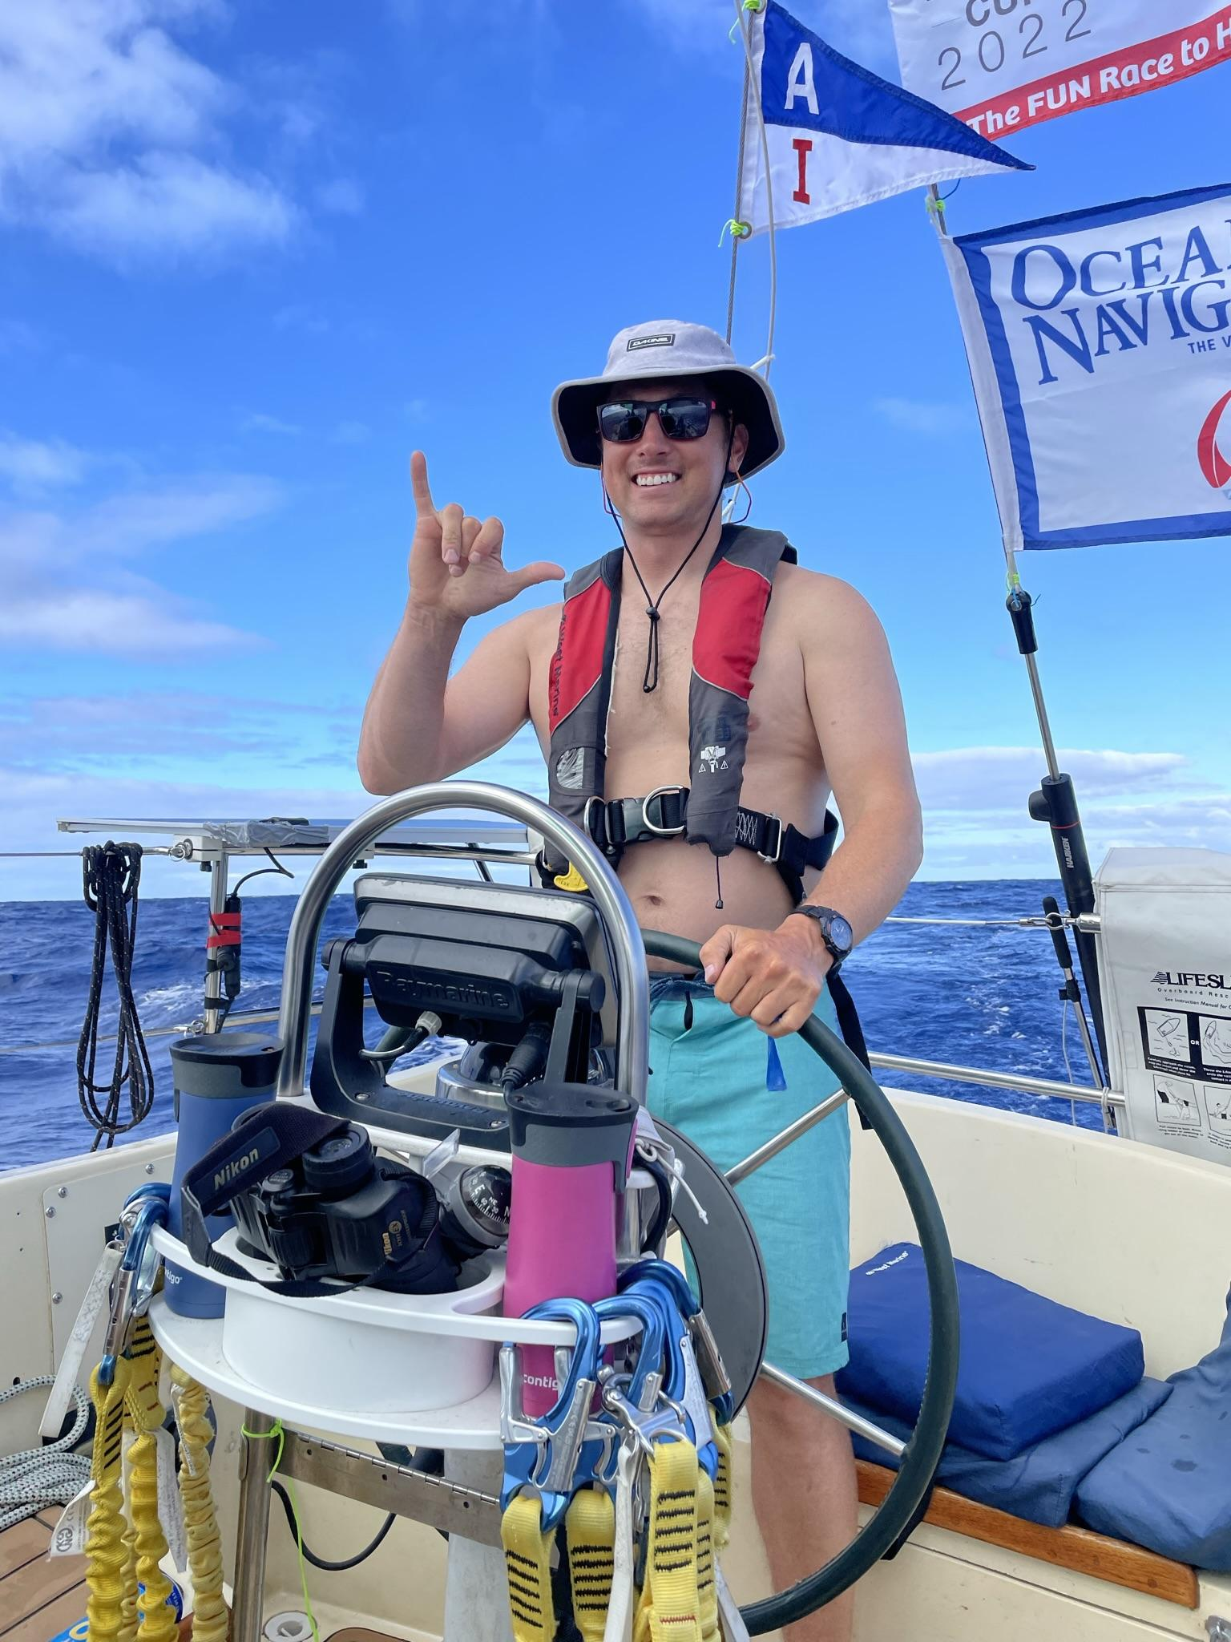
Necessary:
Great crew
Lad Strzok

Slide 9
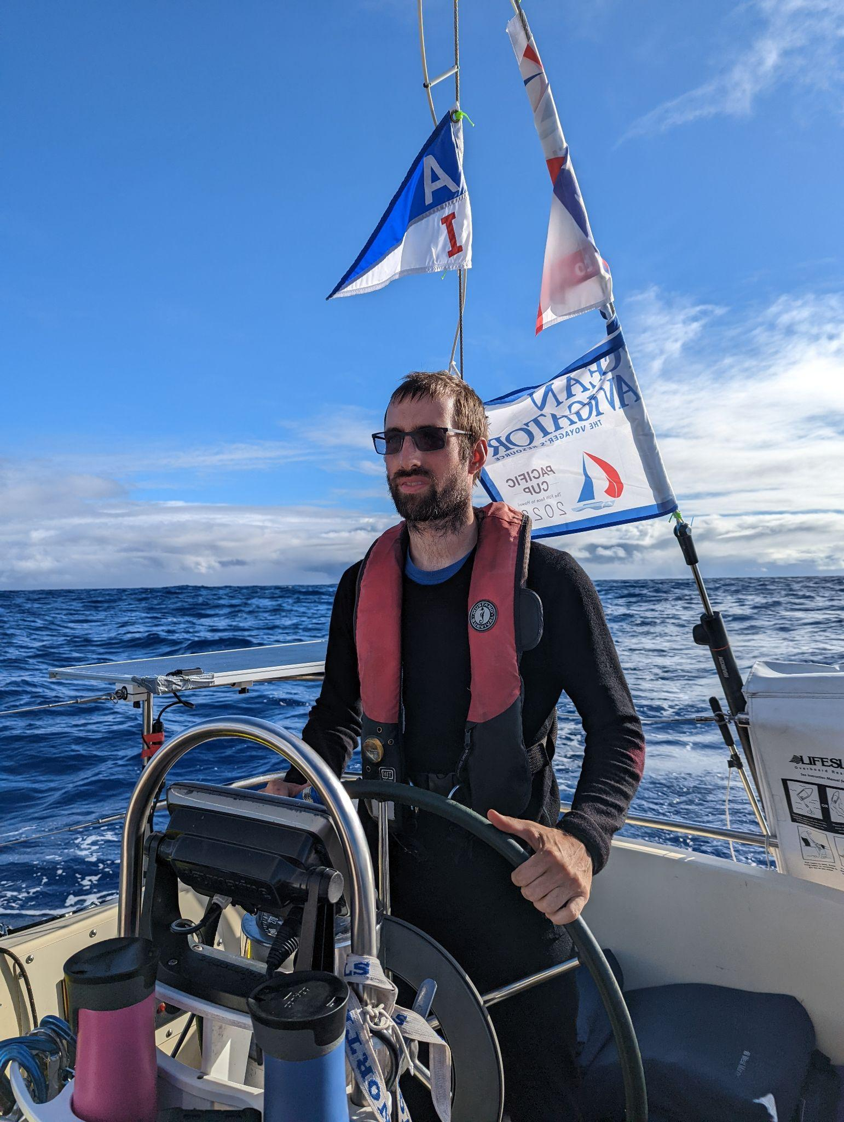
Necessary: Great crew
Nick DeLuca

Slide 10
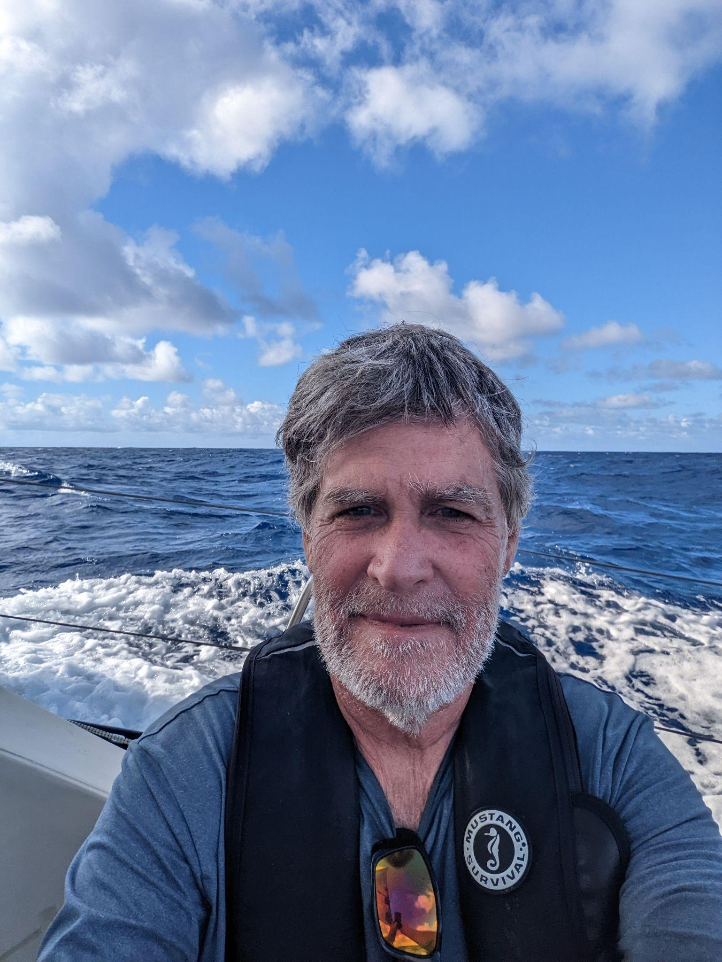
Necessary:
Someone with the desire to enter their boat and see it through

Slide 11
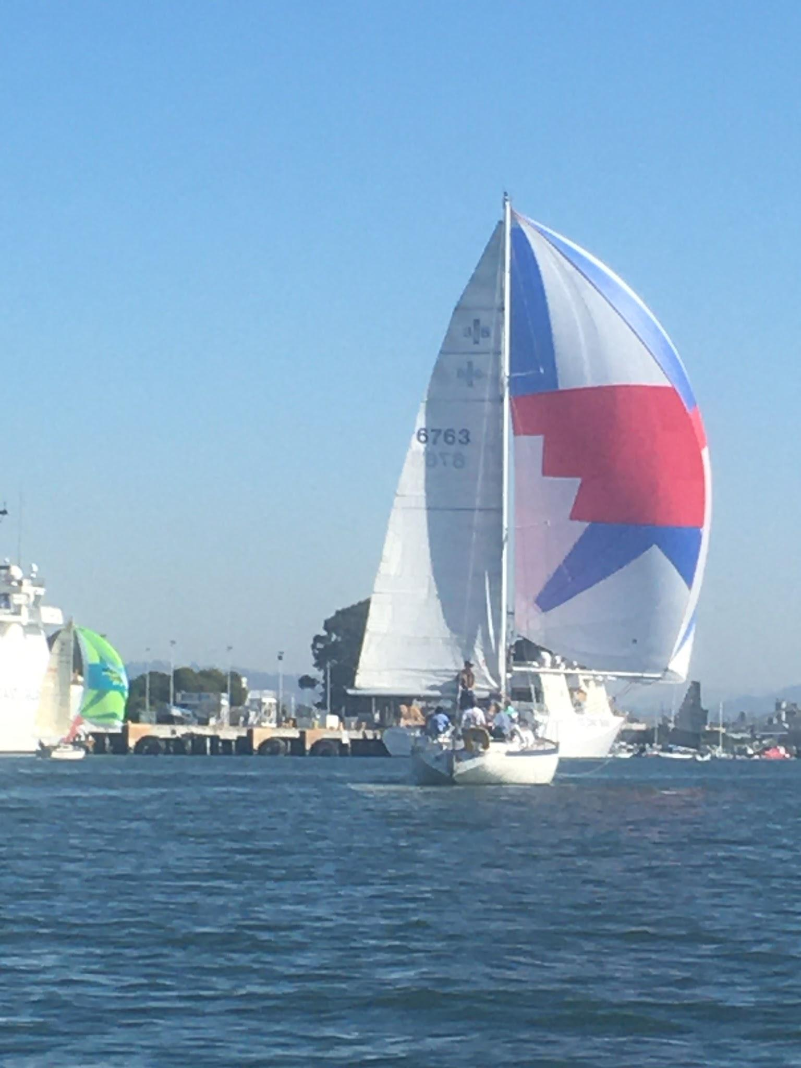
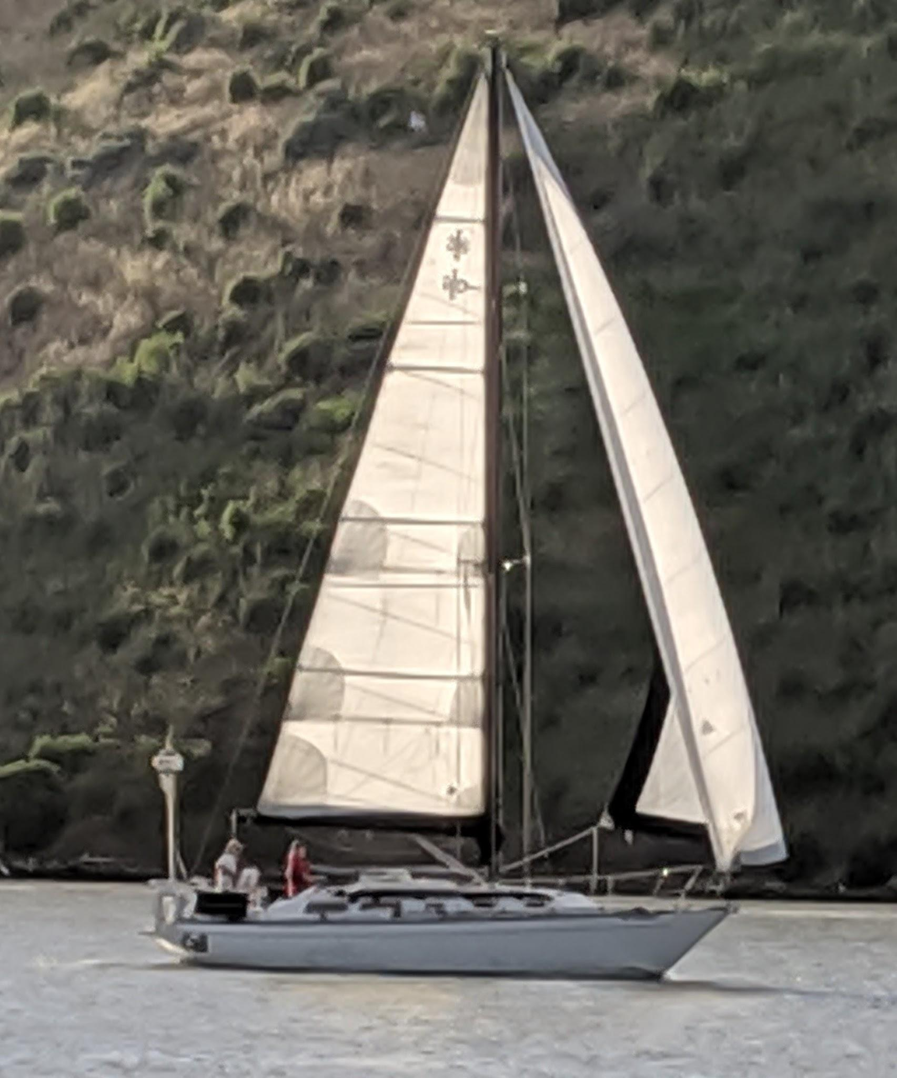
Cassiopeia
Kit Wiegman
Kaz Wiegman
Leo Marek
Rosanne de Vries
Will Pryor
Cali
Kerry Scott
Chuck Reynolds
Tom Bernard
Chris Guinon
Valerie Suzawa

Slide 12
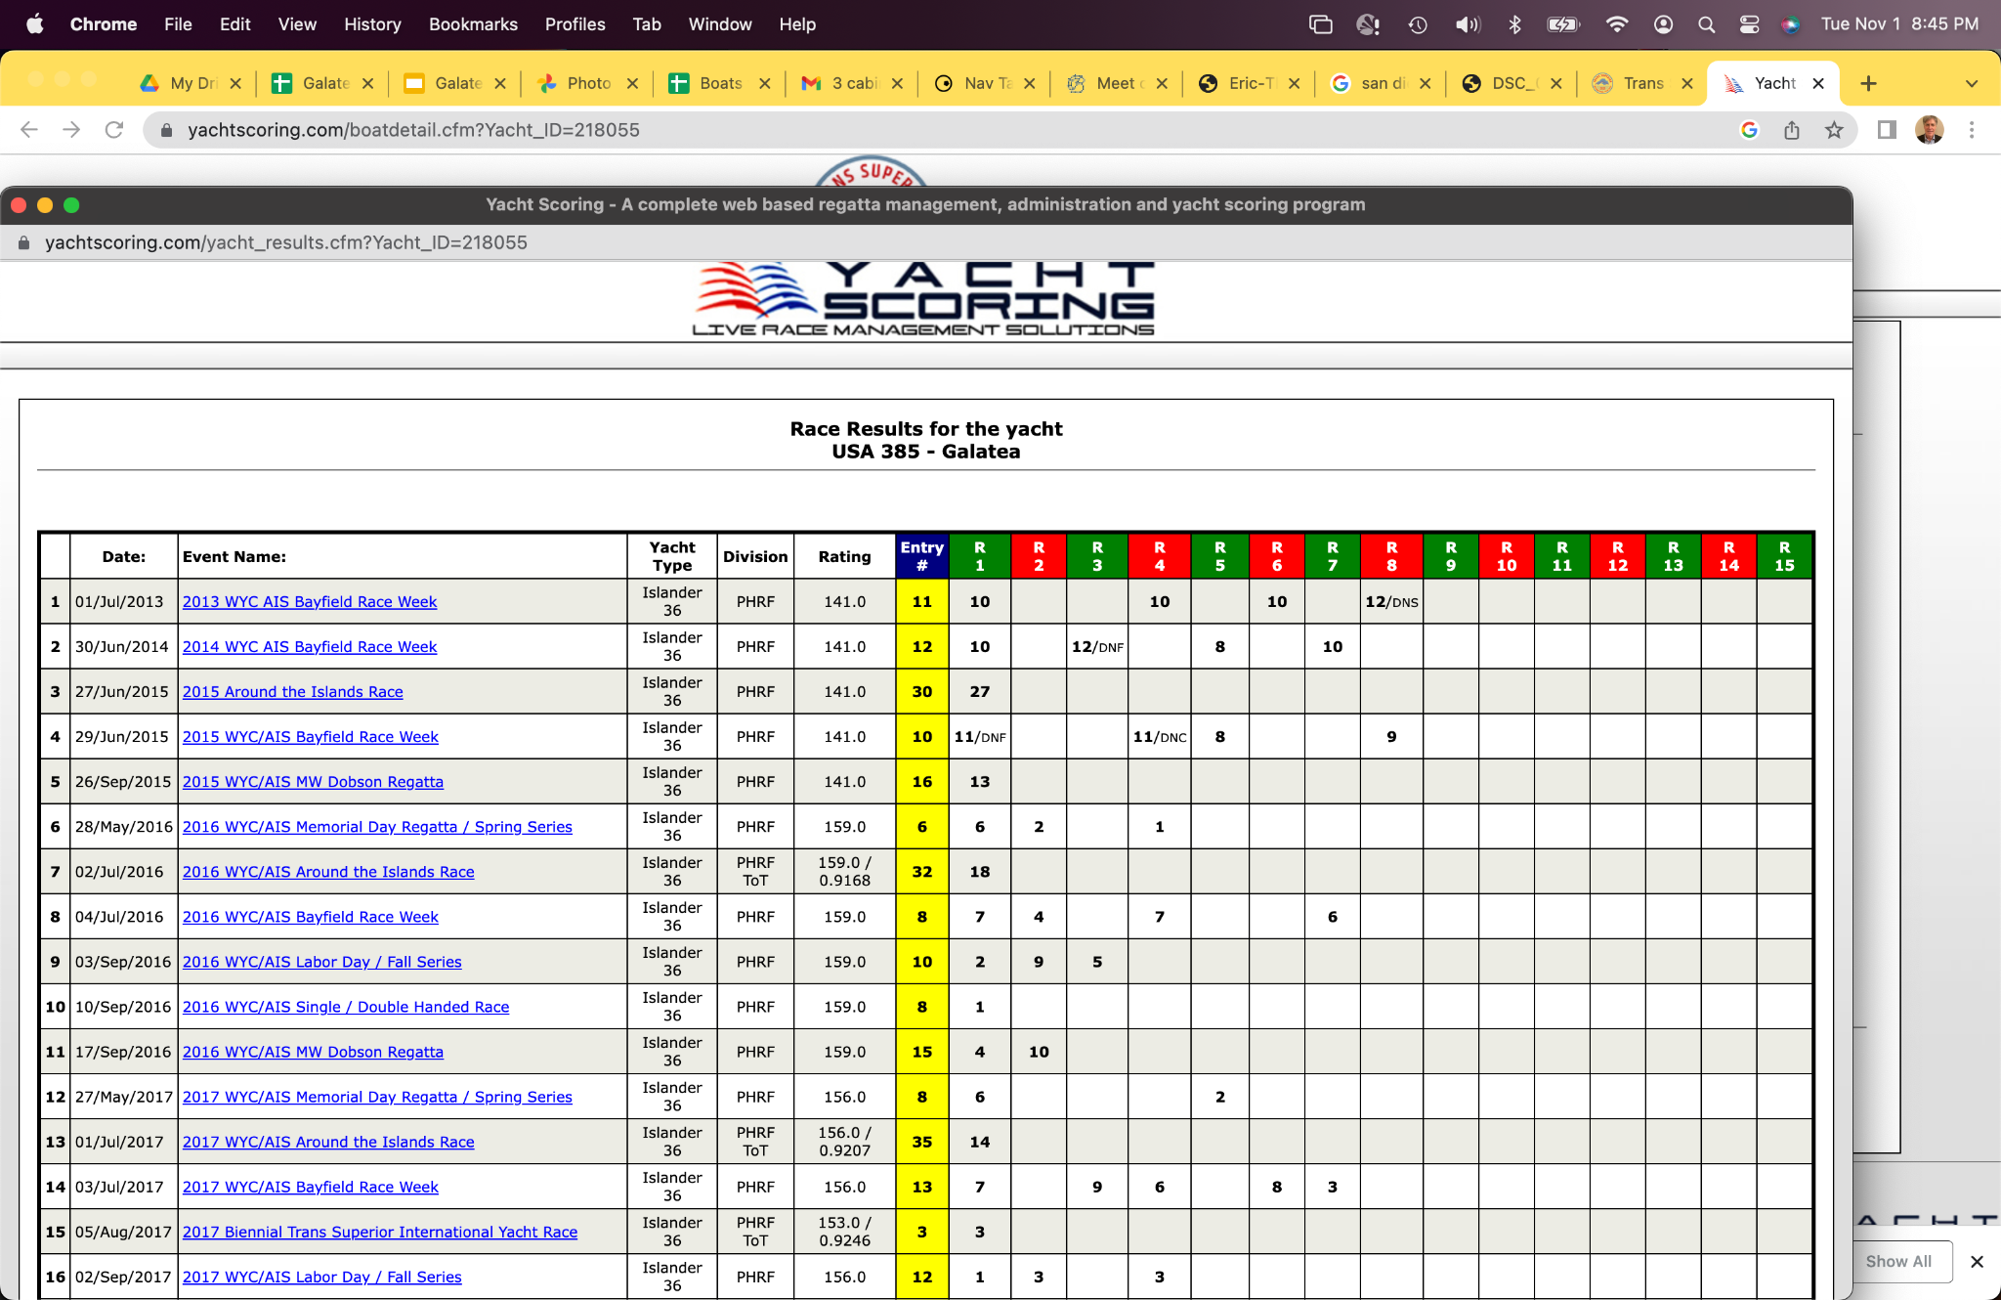
Experience
Had not done an ocean race before
We sail on Lake Superior, Michigan, Huron
Lots of Great Lakes offshore races
Trans Superior
Chicago Mac
Bayview Mac
Many shorter 100 mile races

Slide 13
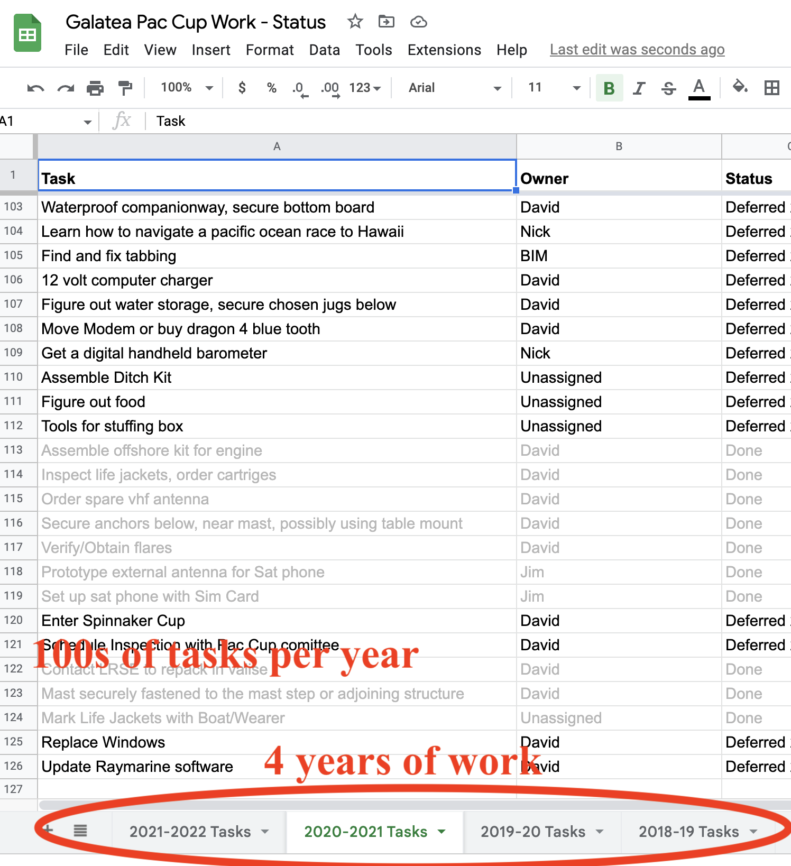
A boat that can make the trip
I-36 not manufactured to sail to Hawaii
40+ year old boat
Design is good
Lots of boat work to get ready
Managing the tasks is important
Getting it done
Doing the right thing

Slide 14
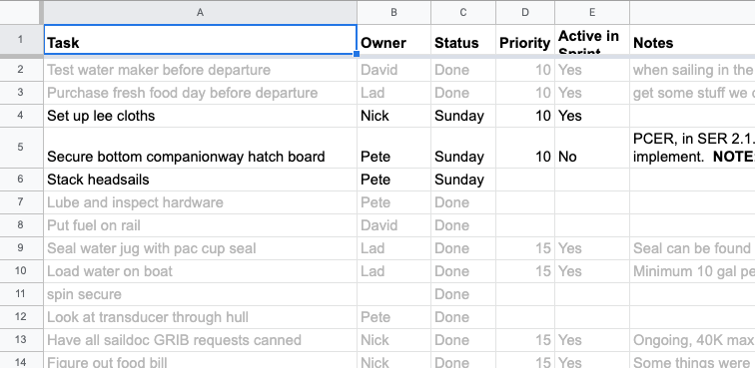
Management via weekly “standups” and “sprints”
From software development “agile” process
Move tasks each week by assigning to individuals
Using the task spreadsheet
Many trips to the boat
Mostly on Saturdays

Slide 15
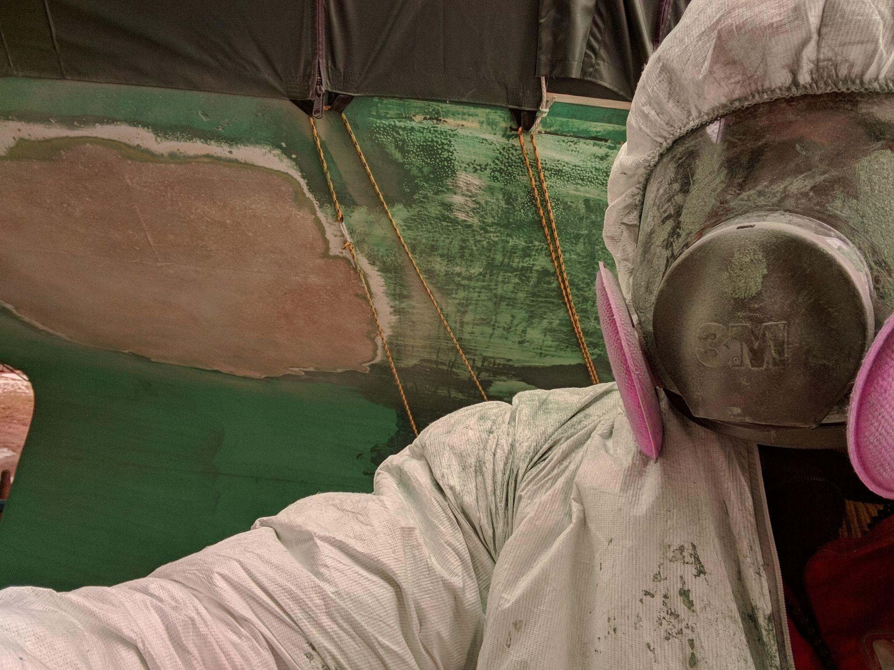

Slide 16
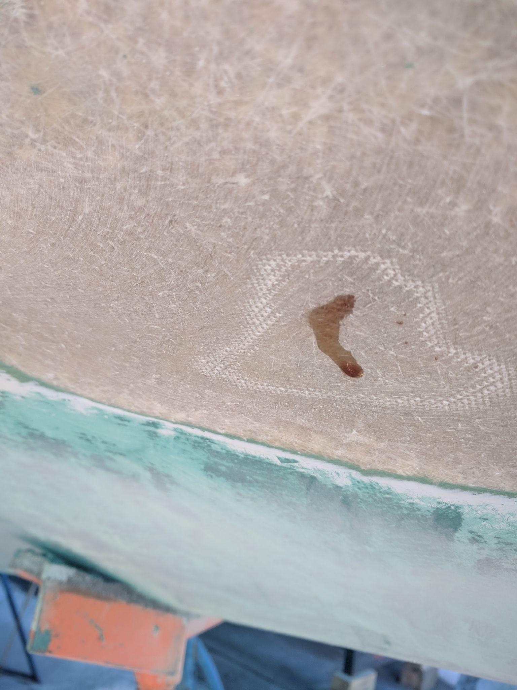
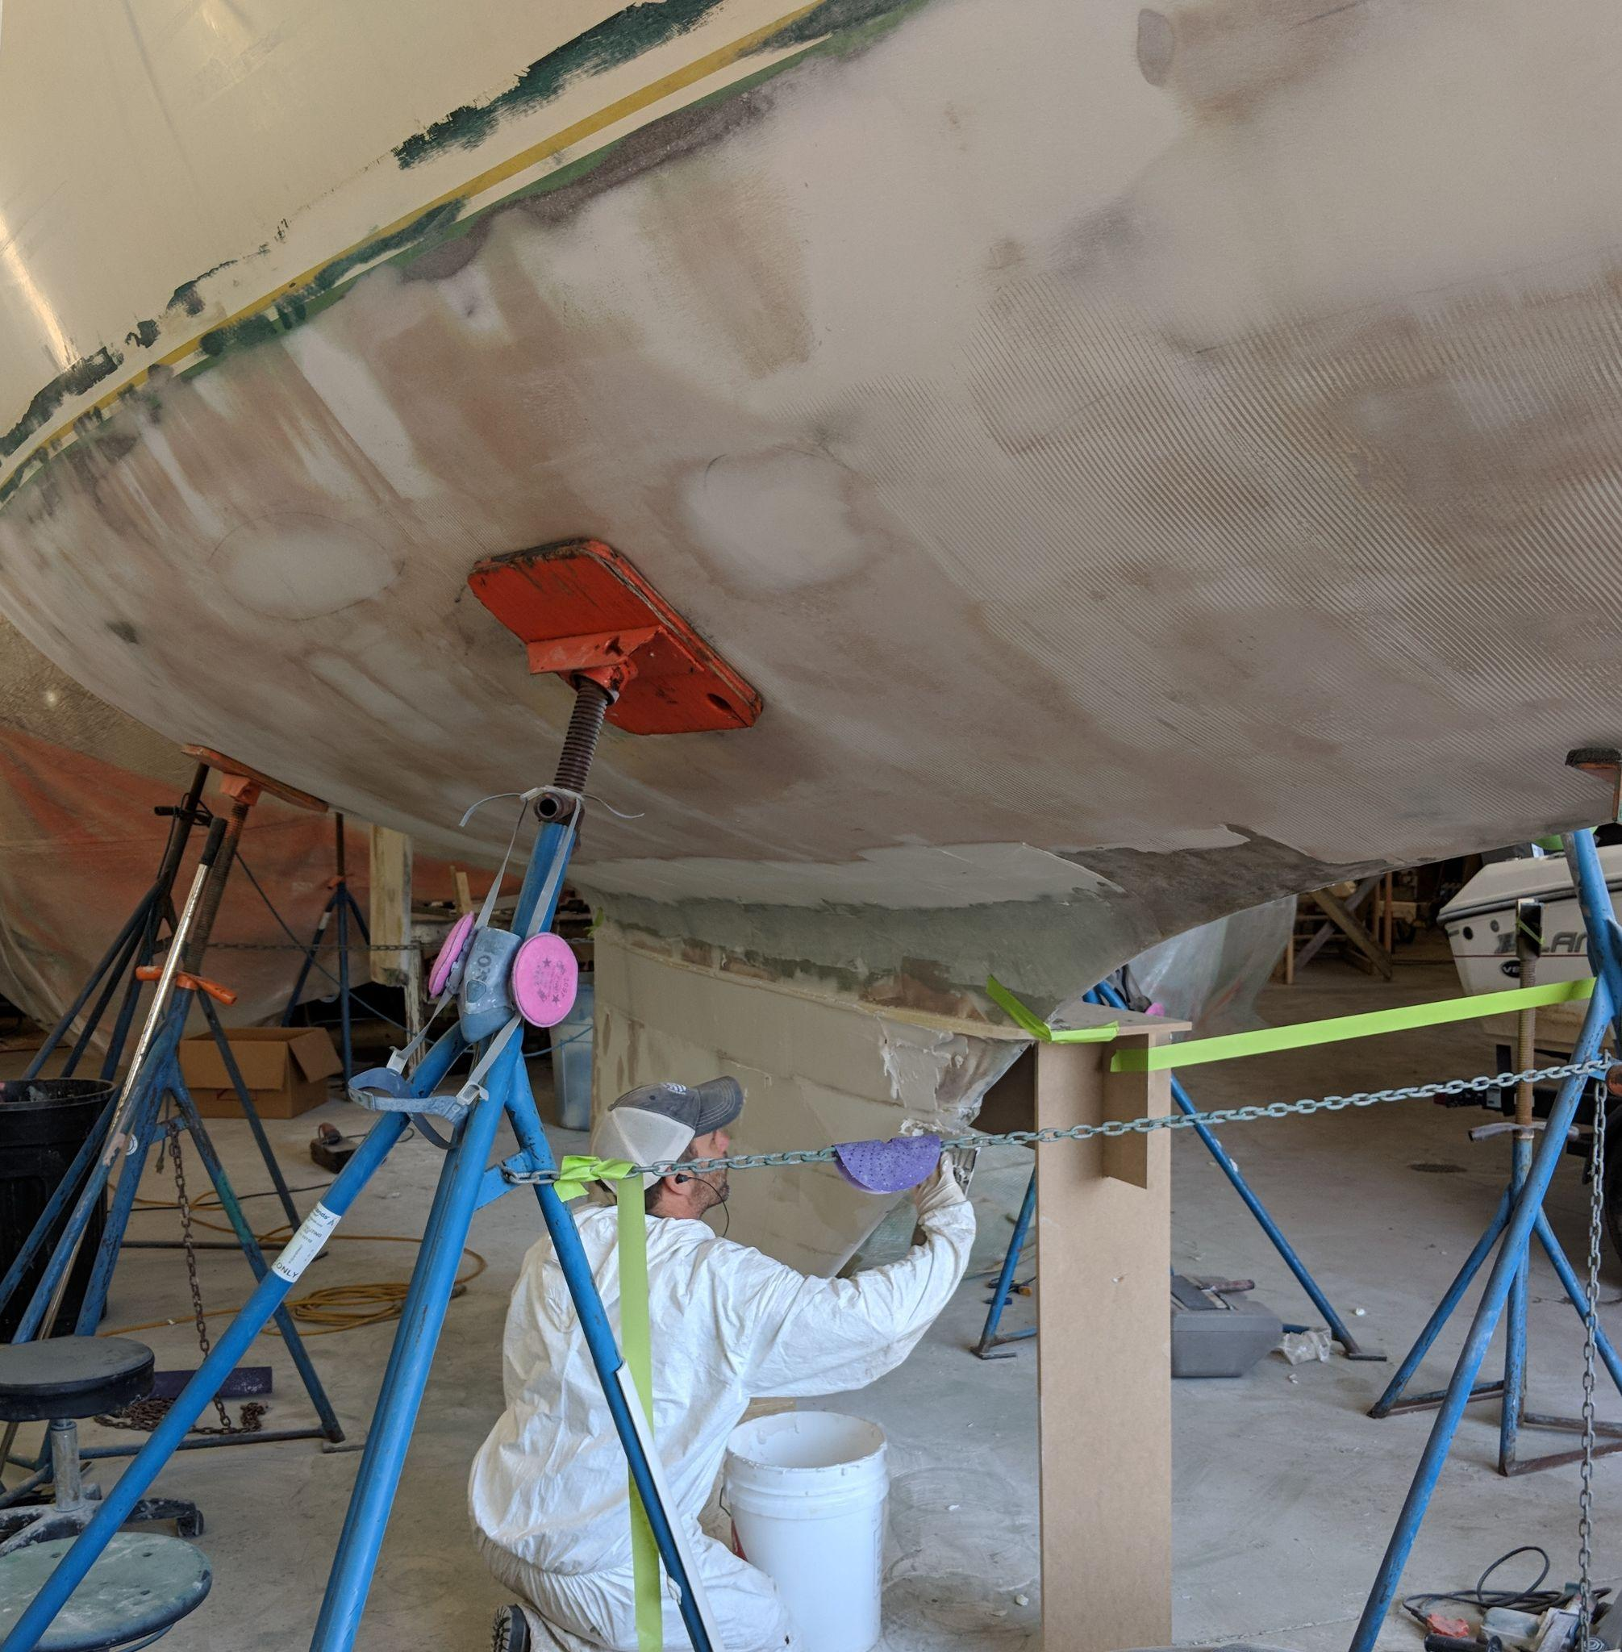

Slide 17
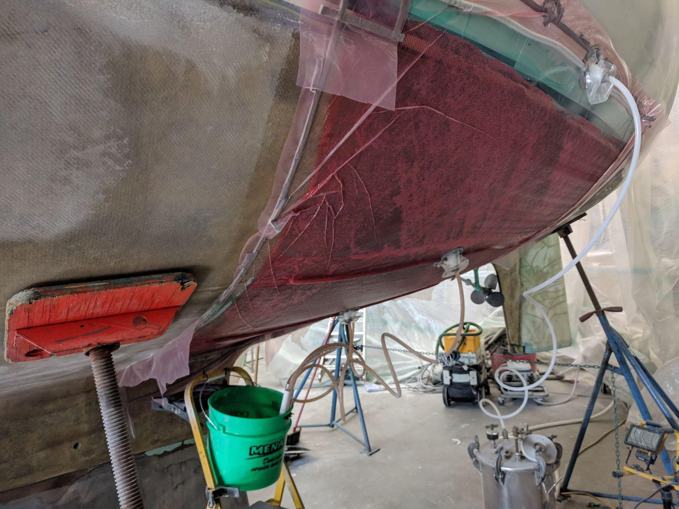

Slide 18
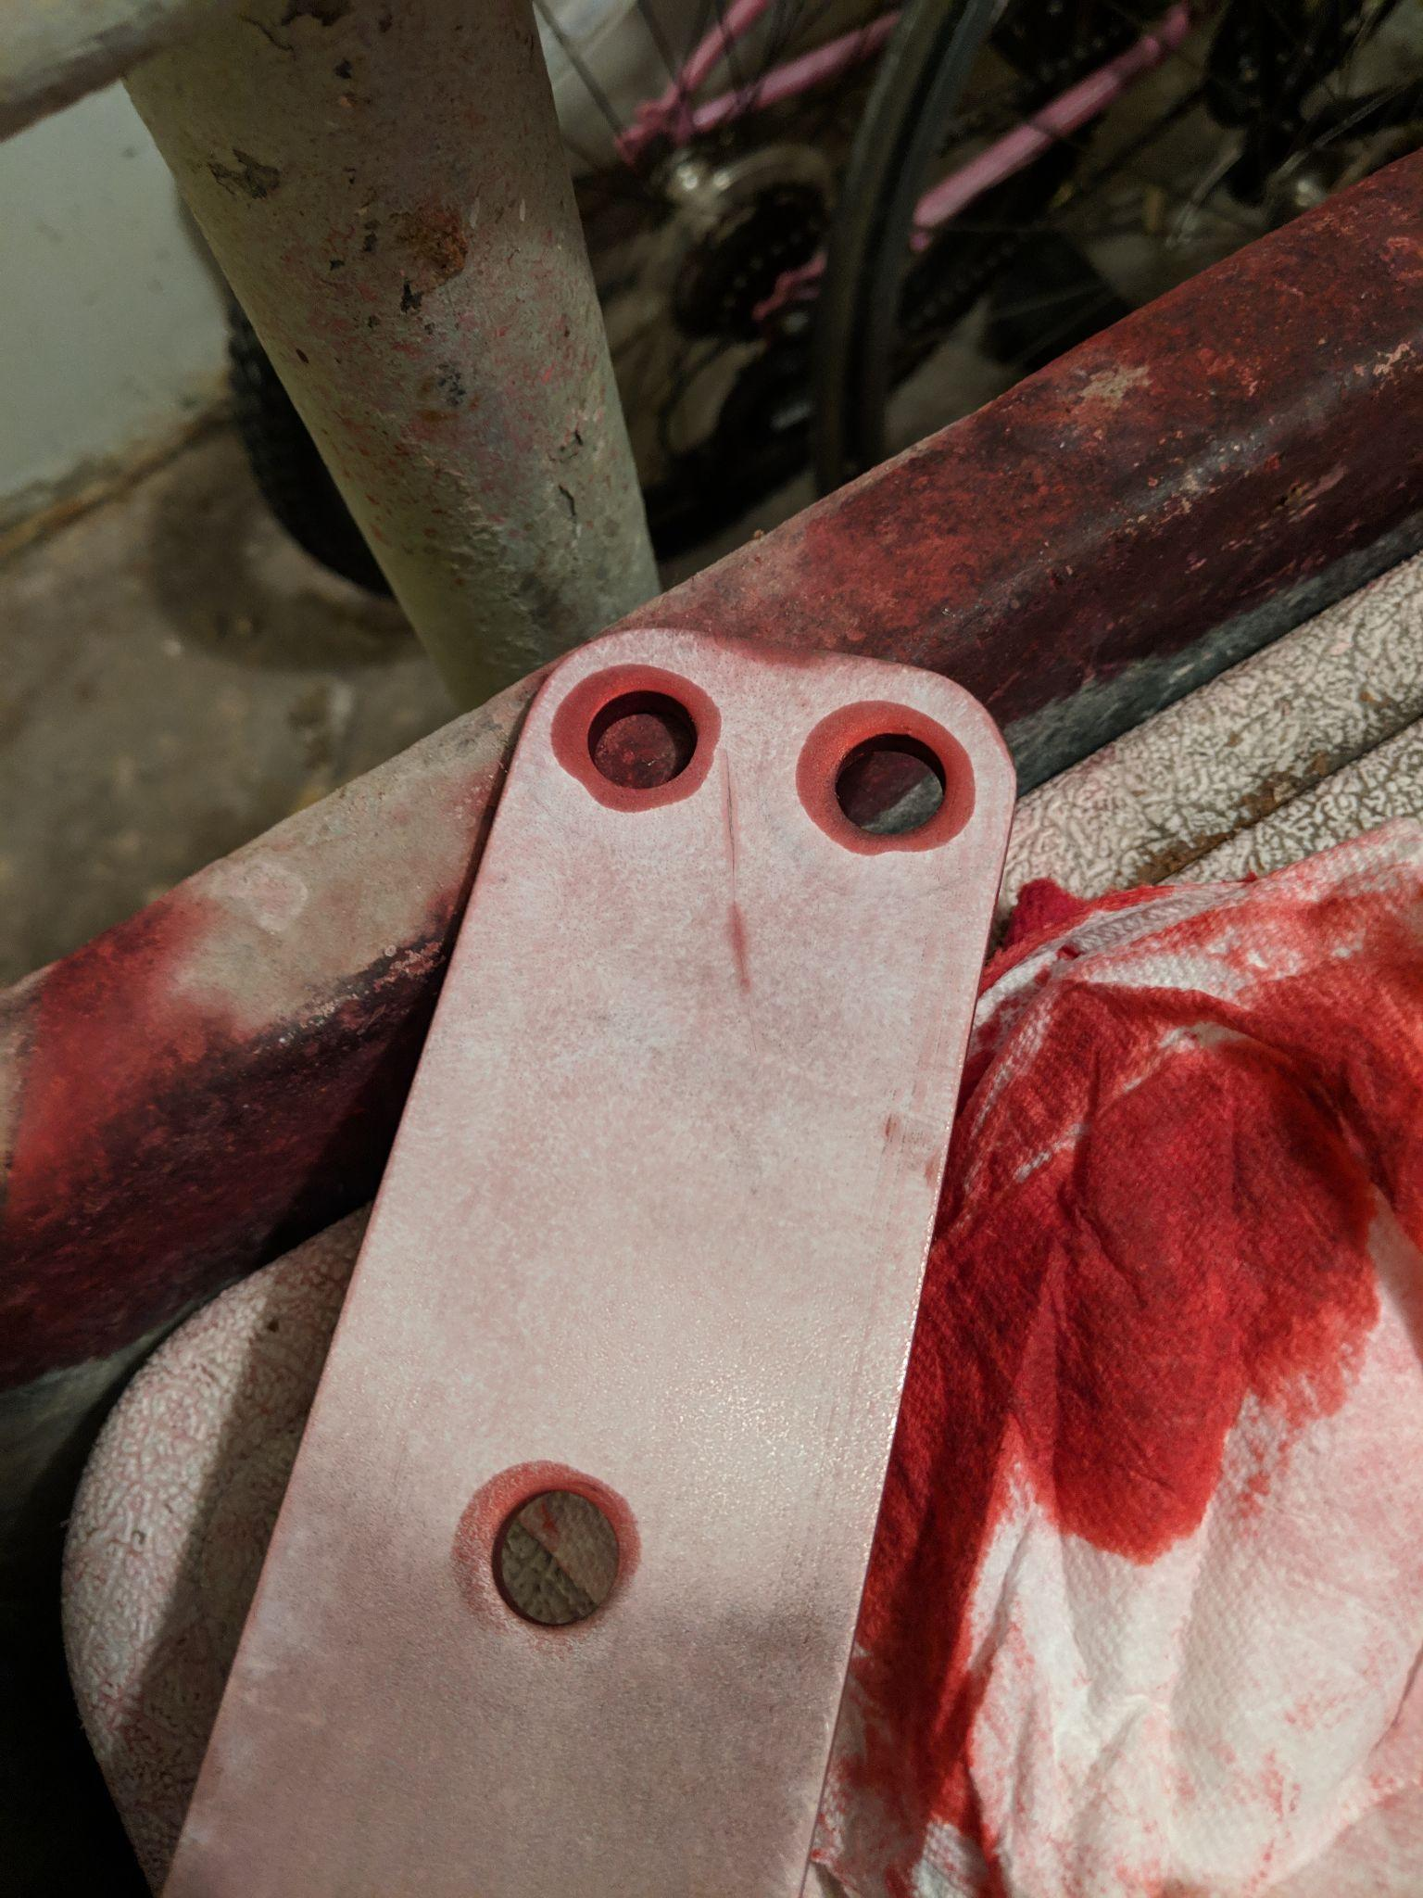
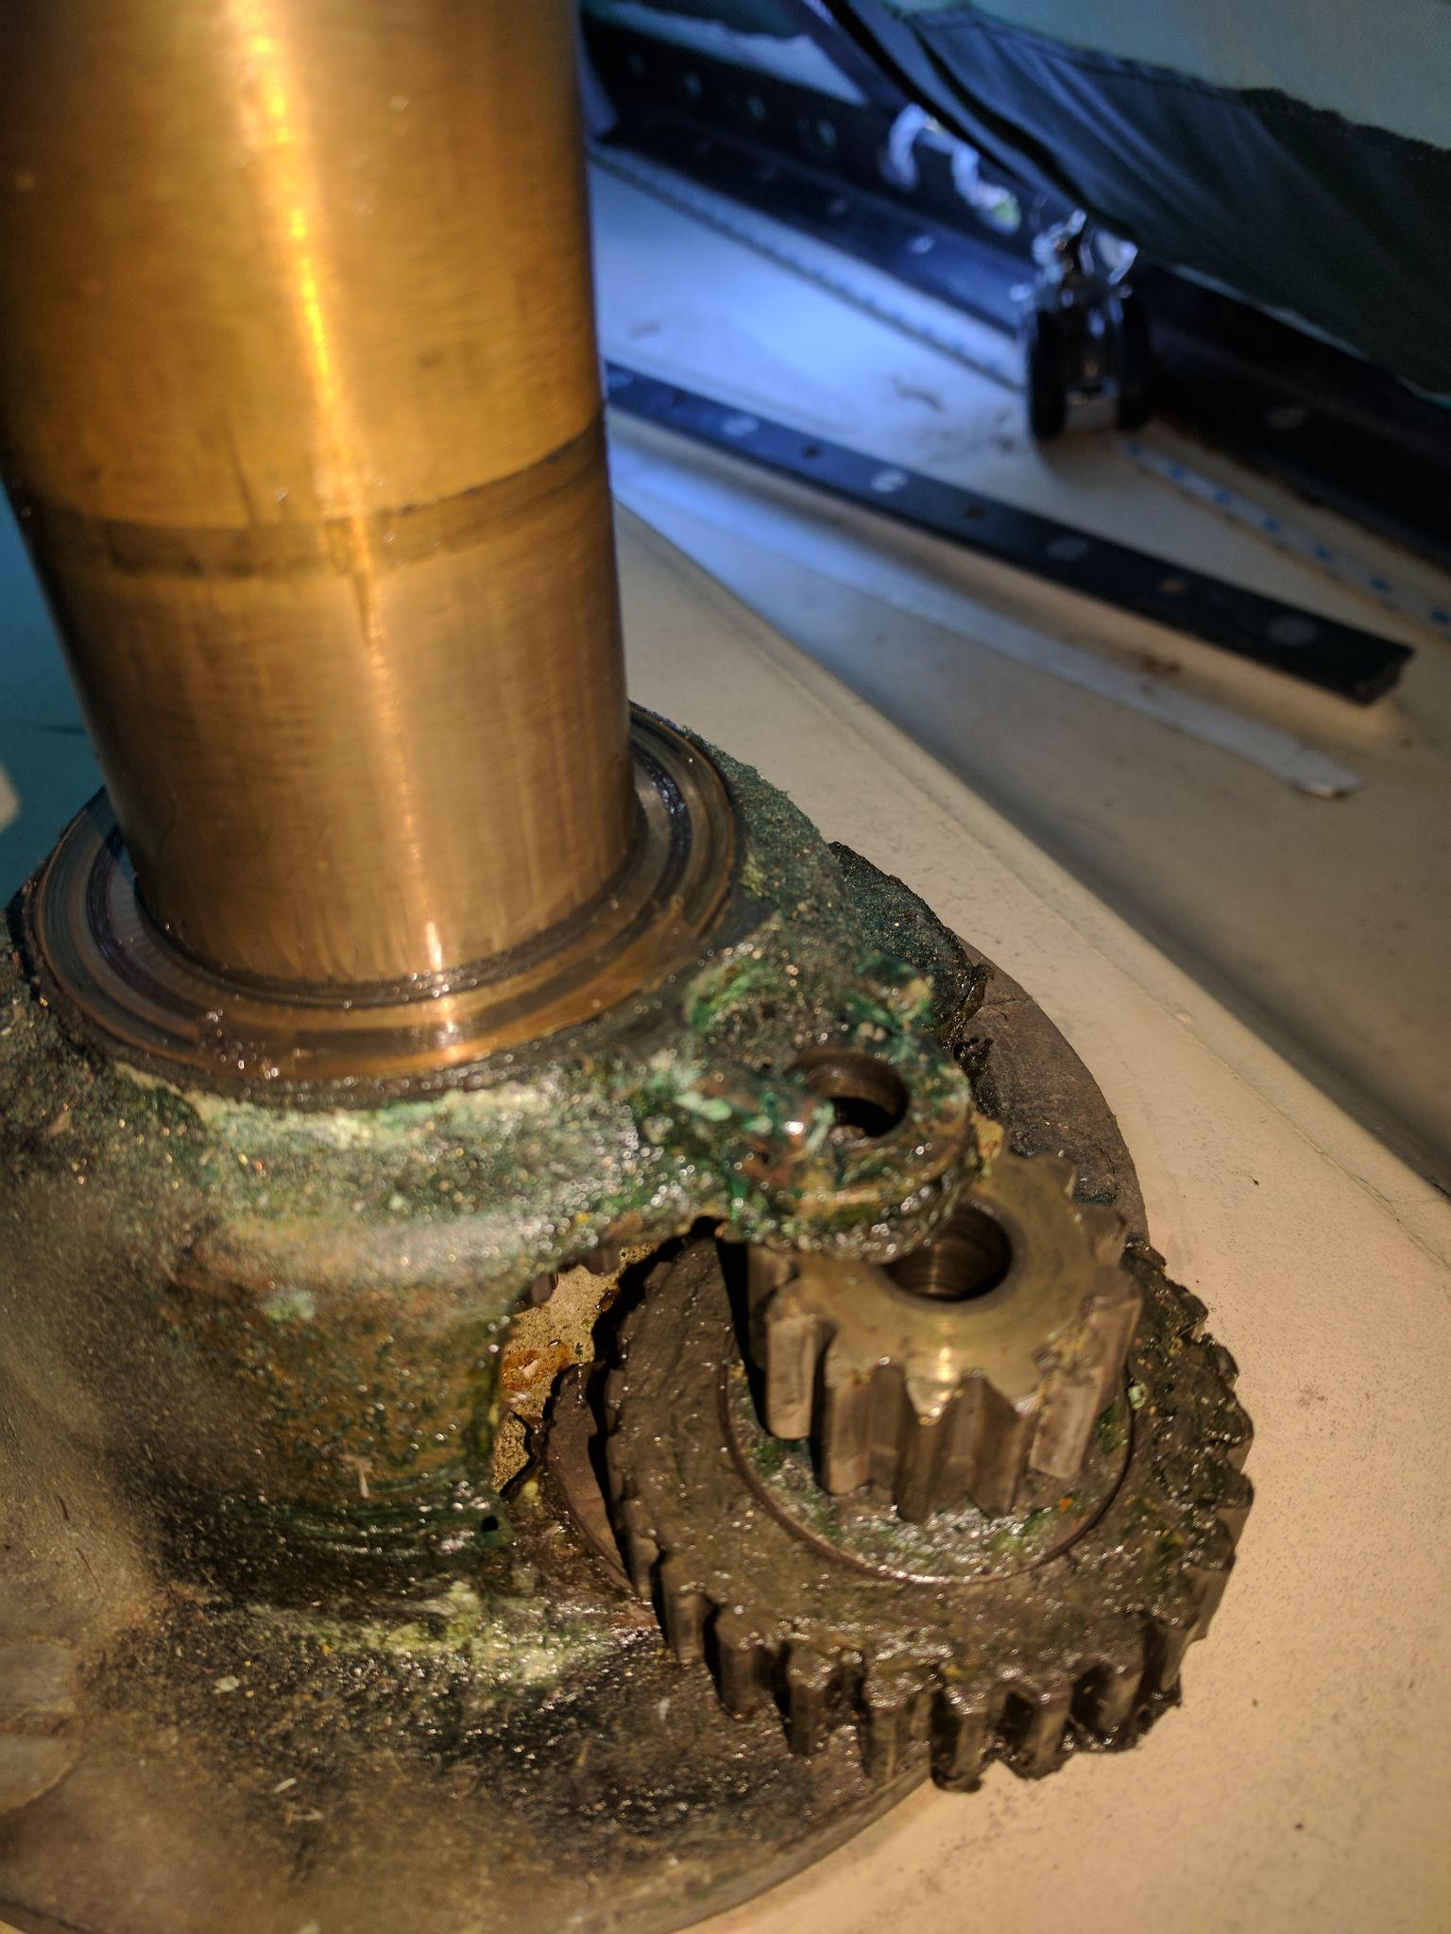

Slide 19
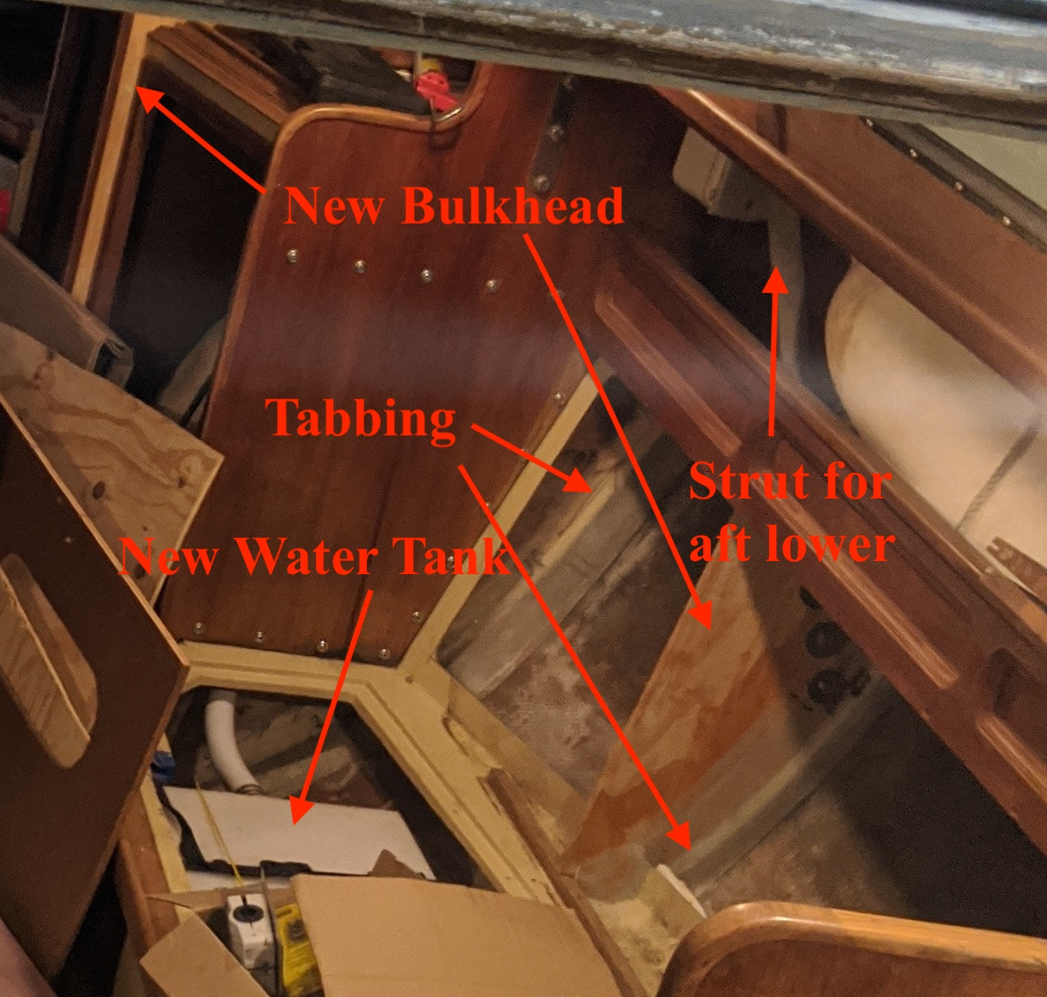
Tabbing
Bulkheads
Structure
Take everything apart
Rebuild it
Make it better

Slide 20
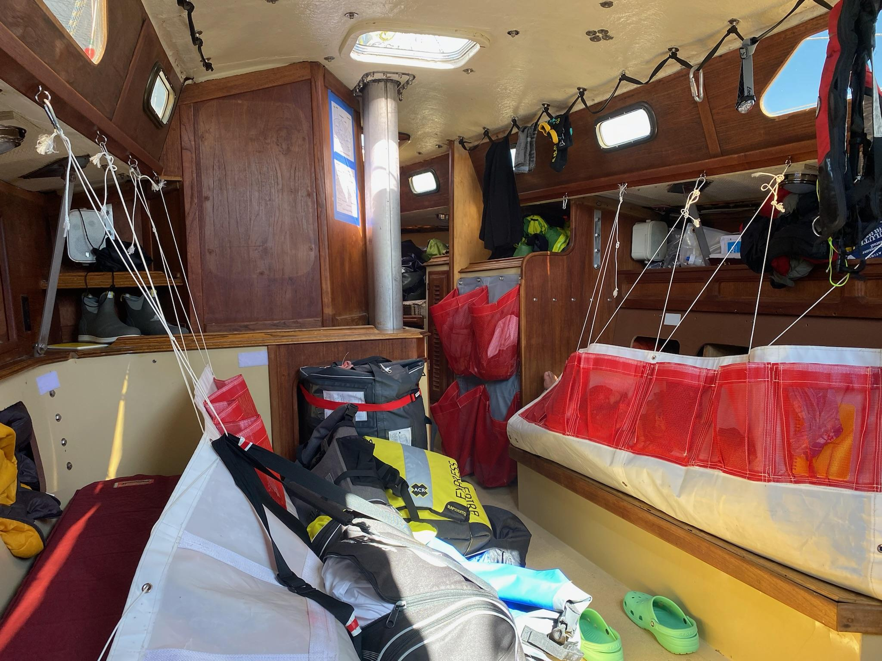
Modifications
No headliner
Handholds
Lee cloths
No alcohol stove
Jetboil
Watermaker!
Trash receptacle
Jump seat

Slide 21
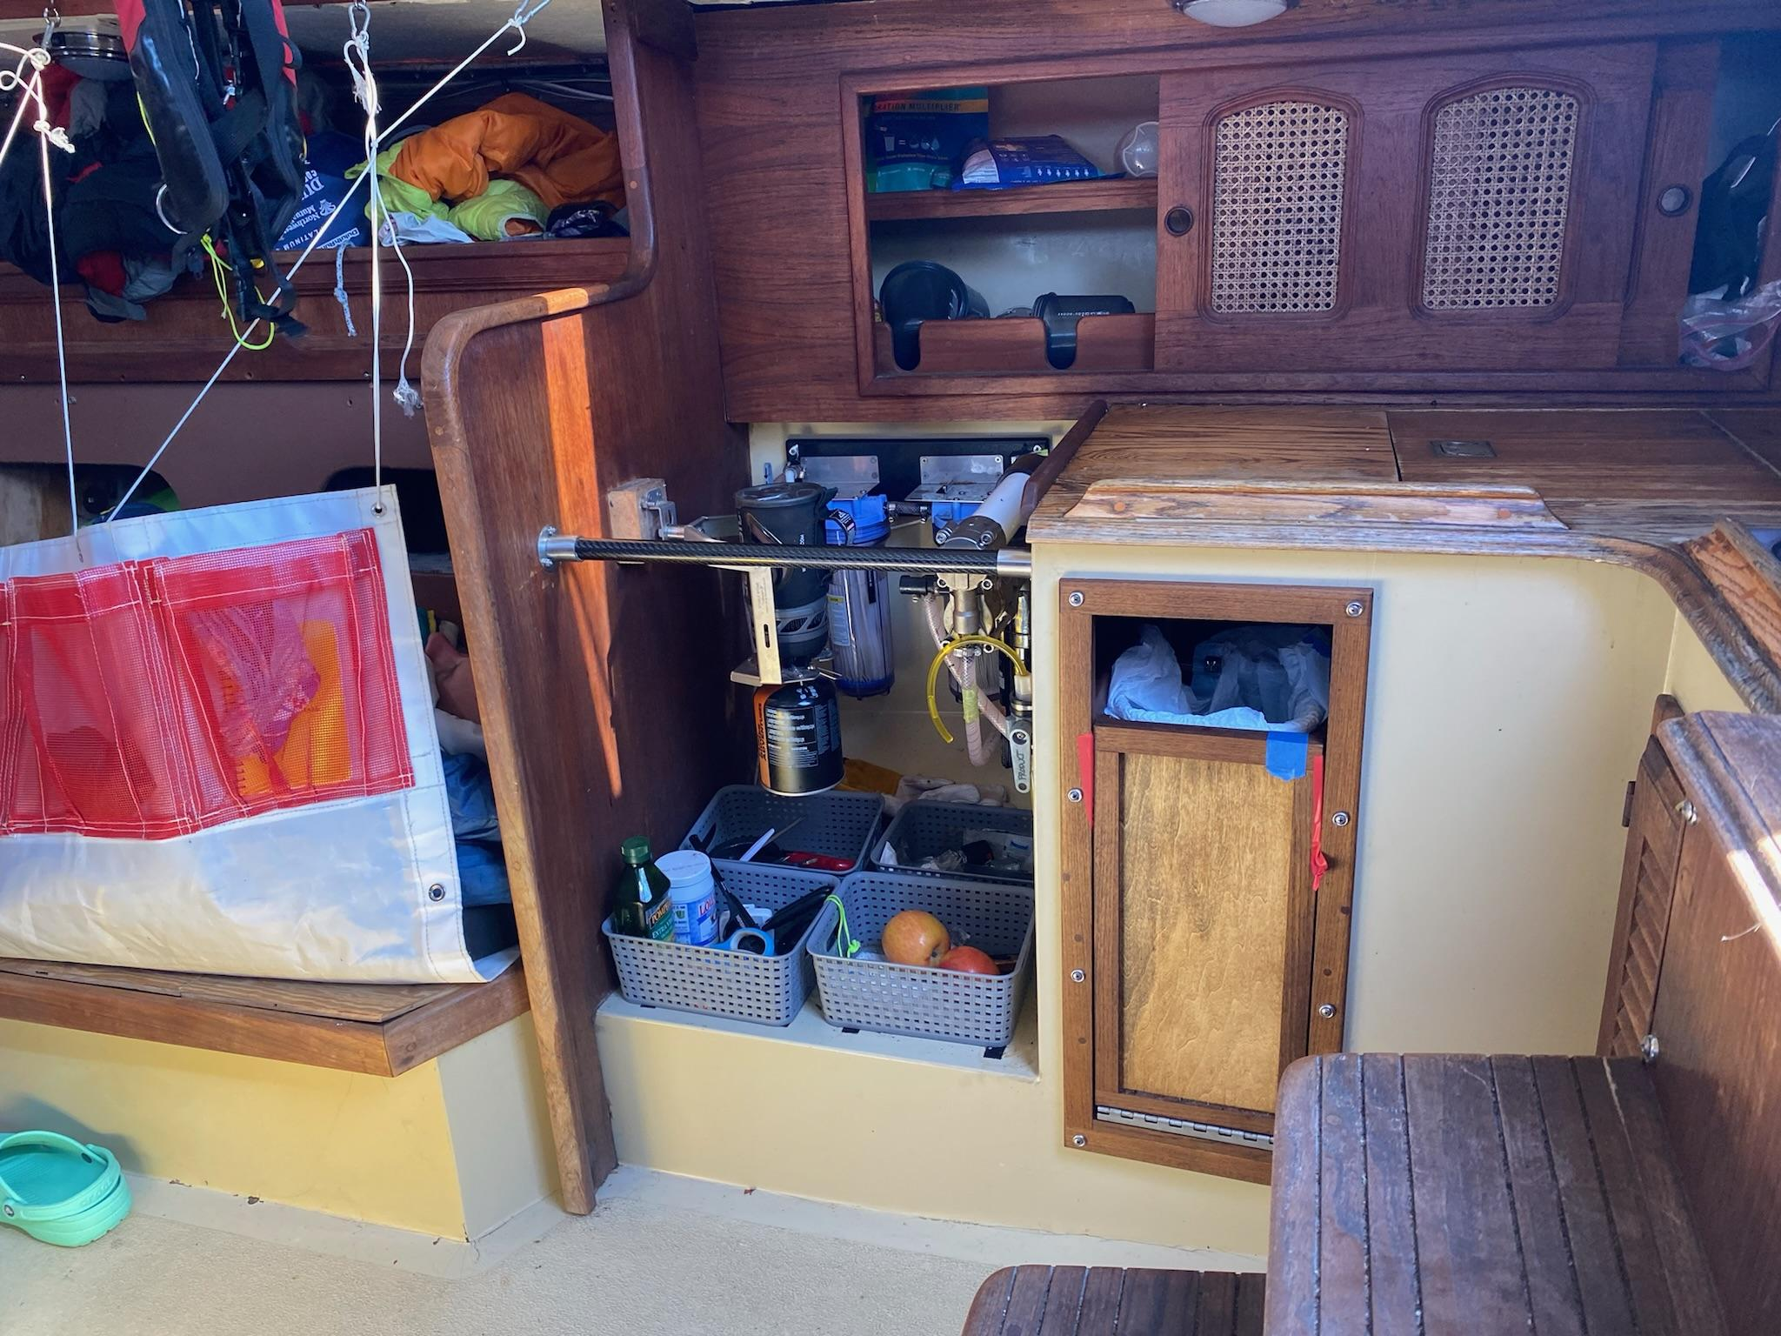

Slide 22
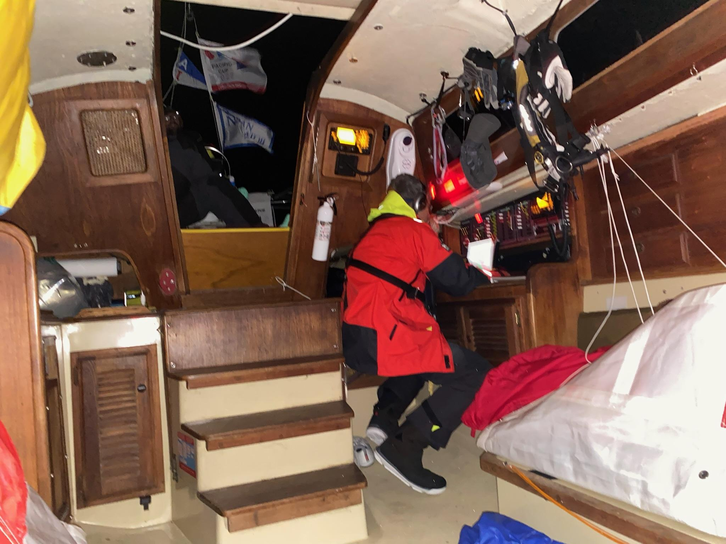

Slide 23
How do you sail a race from SF to HI?
None of us aboard Galatea had done this before
Resources
Pacific Cup Website
Eric who had done Single Handed Transpac
Kit who had done 4 Pac Cups in I-36 before 2022 and much more

Slide 24
Deal with the unexpected
Cancellation of 2020 due to COVID
Had intended to do Pacific Cup in 2020
My experience in August 2021

Slide 25
Big Picture
14 to 16 days
Other I-36 Pac Cup and Single Handed Transpac in that range
Light air very possible
Bring #1, #2, #3
Lots of downwind of course, so bring all 4 spinnakers
S2, S4, A2, A3
Range of optimal courses is wide
Are there patterns to distinguish years?

Slide 26
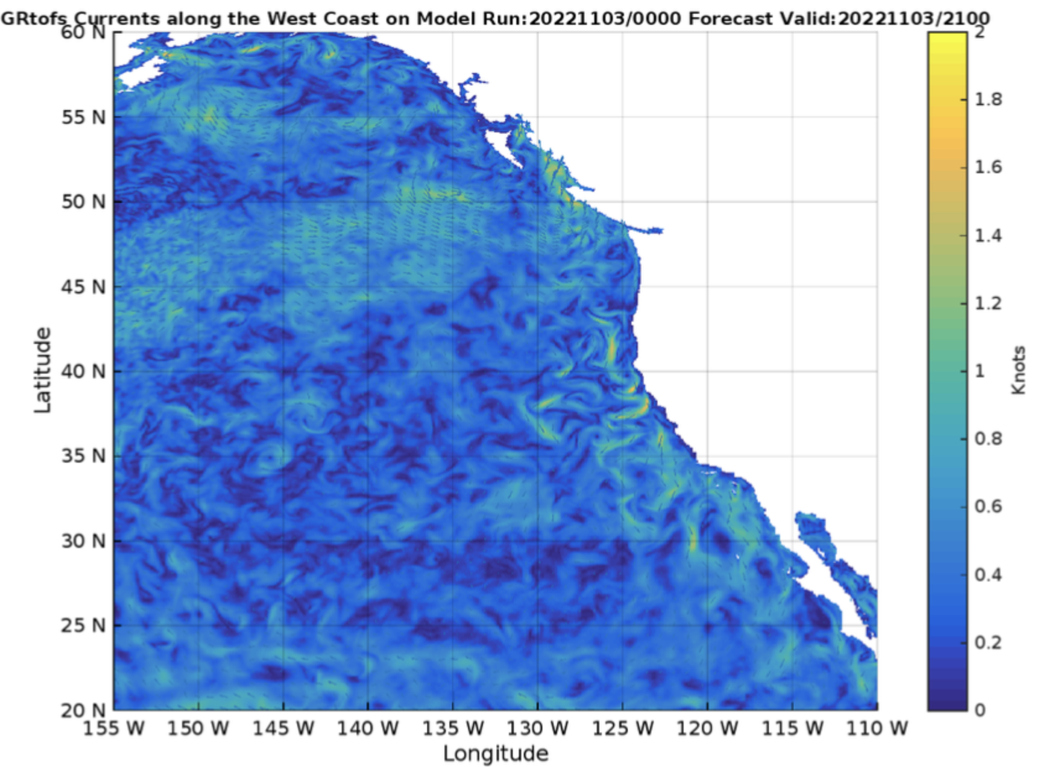
There are currents out there.
John, our navigator, positioned us to take advantage.

Slide 27
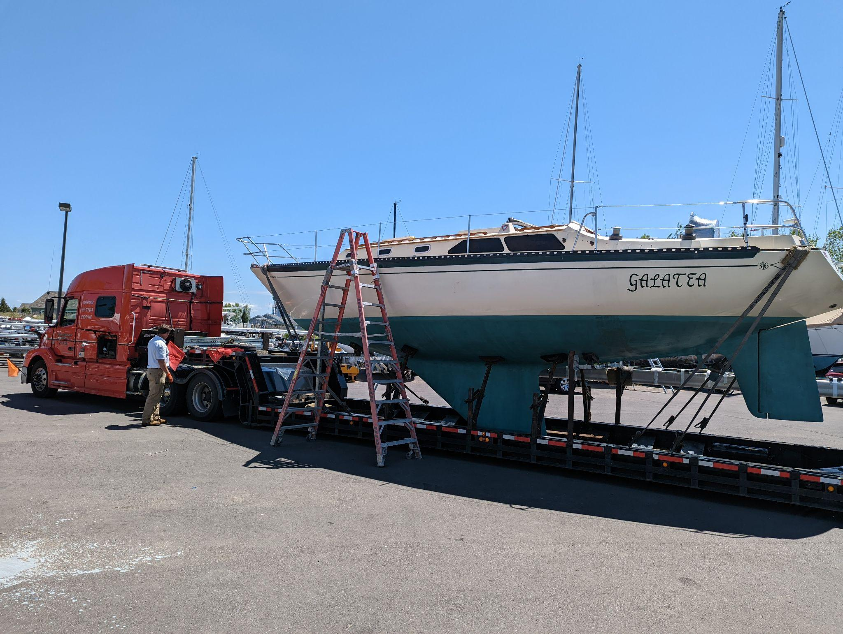
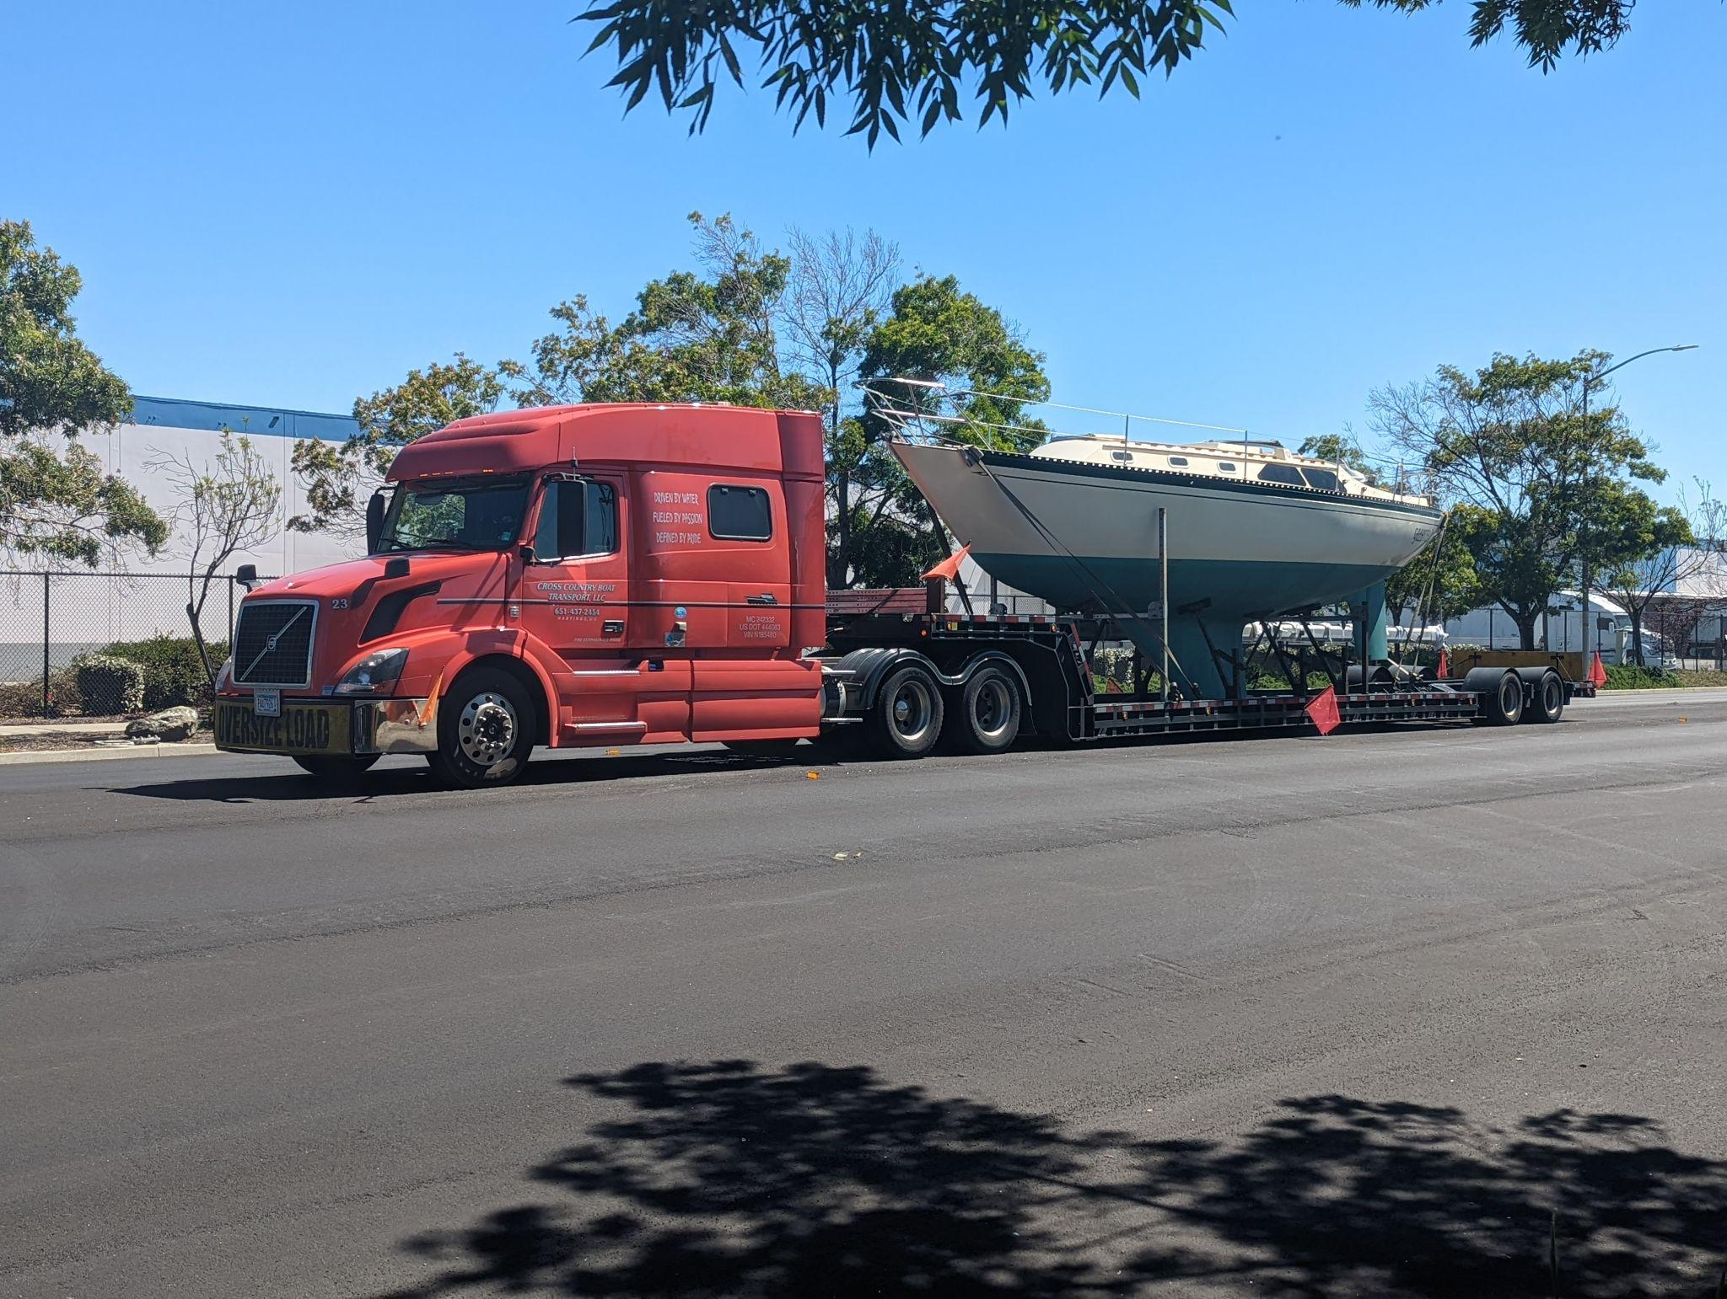
Get the boat from Superior WI to San Francisco CA
Get the boat ready to sail

Slide 28
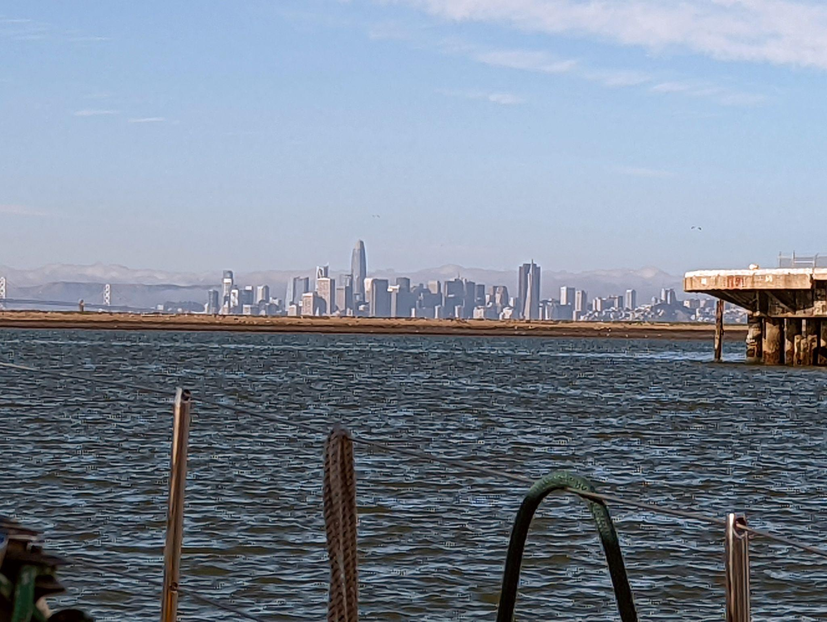

Slide 29
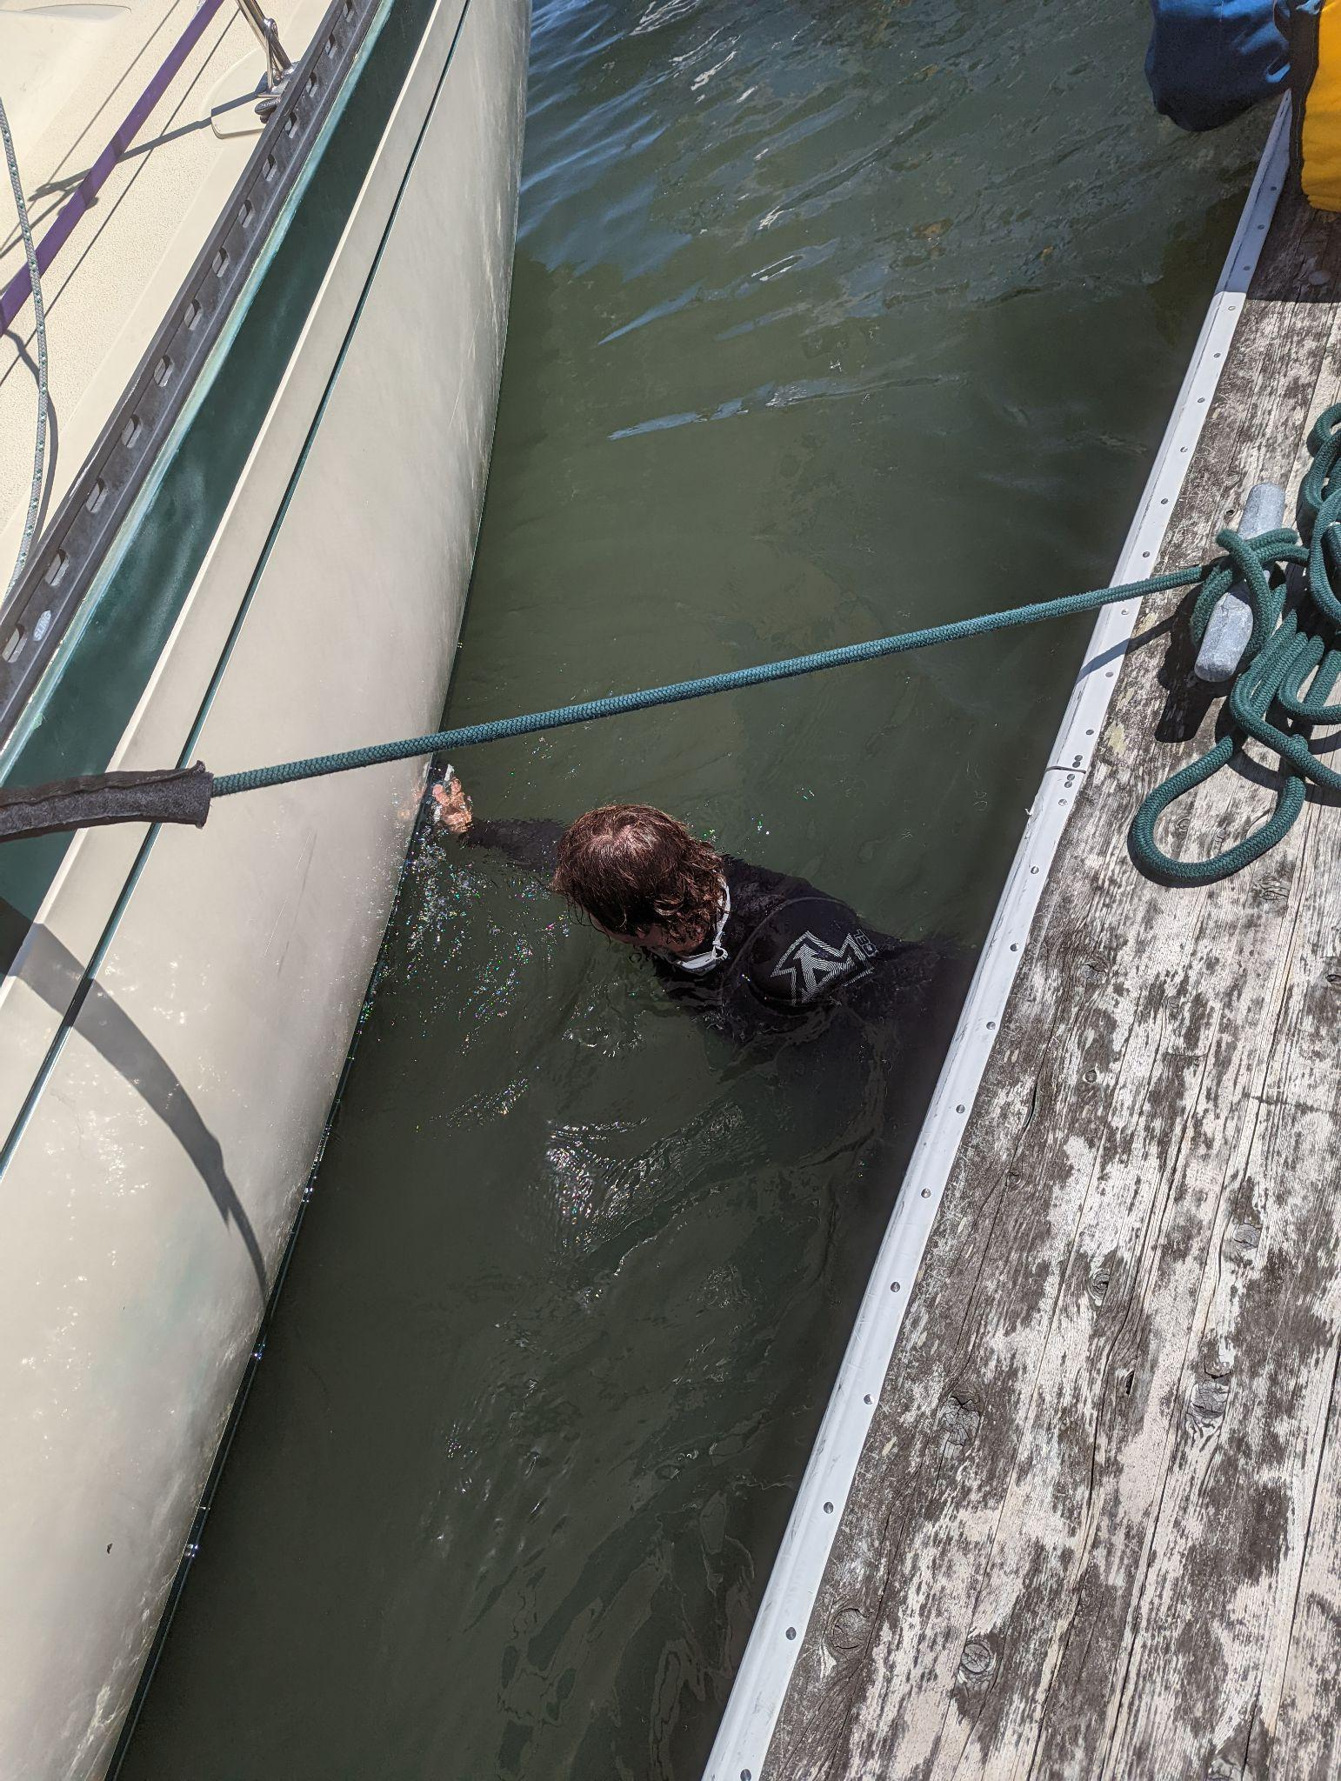
The day before departure John dove to scrub the bottom
Spent two hours!

Slide 30
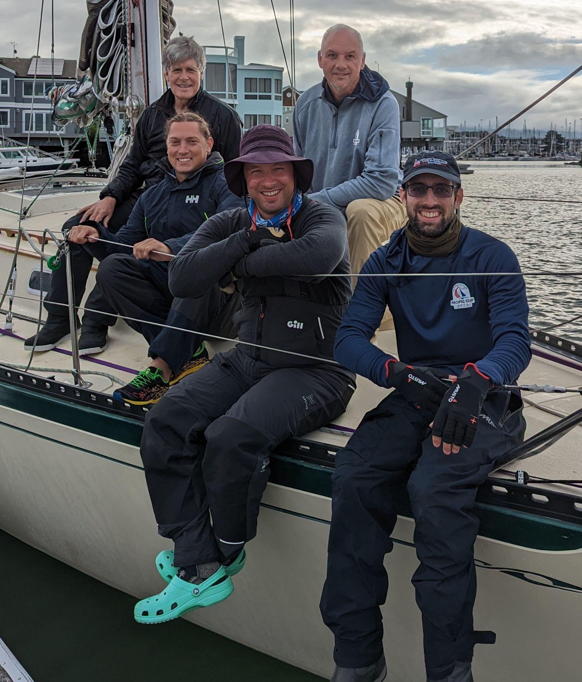
Morning of departure
Monday July 4, 2022
We’d taken COVID tests, all were negative

Slide 31
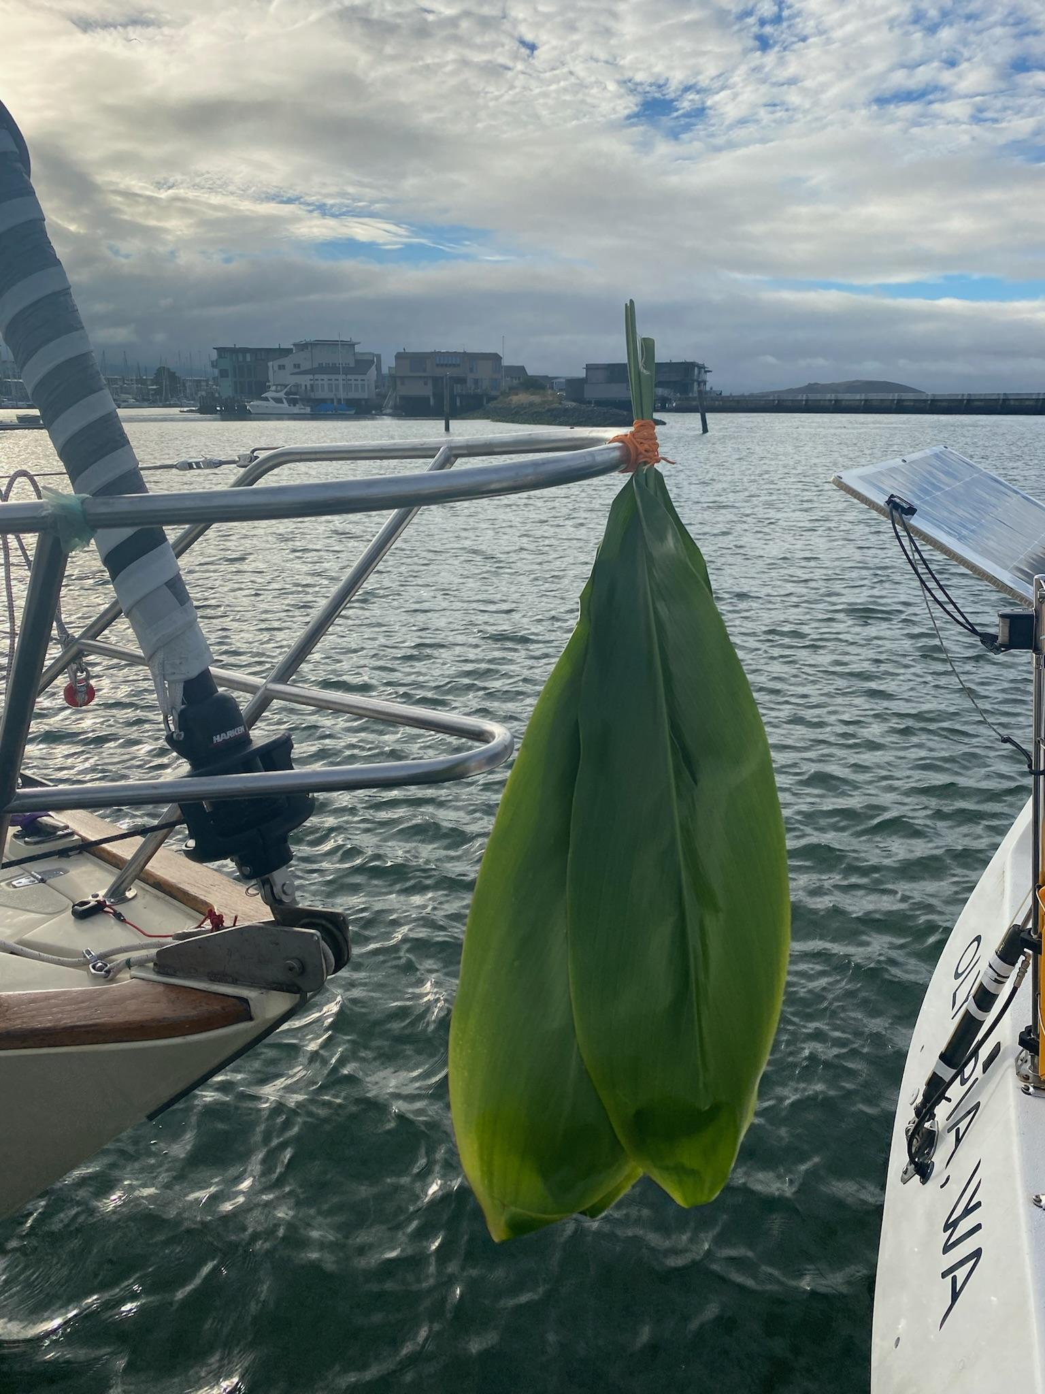

Slide 32
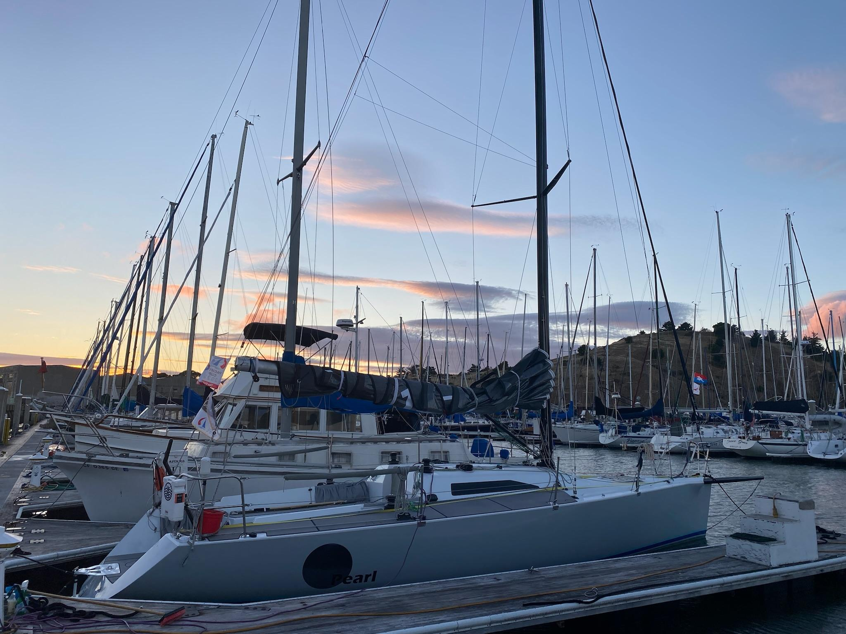

Slide 33
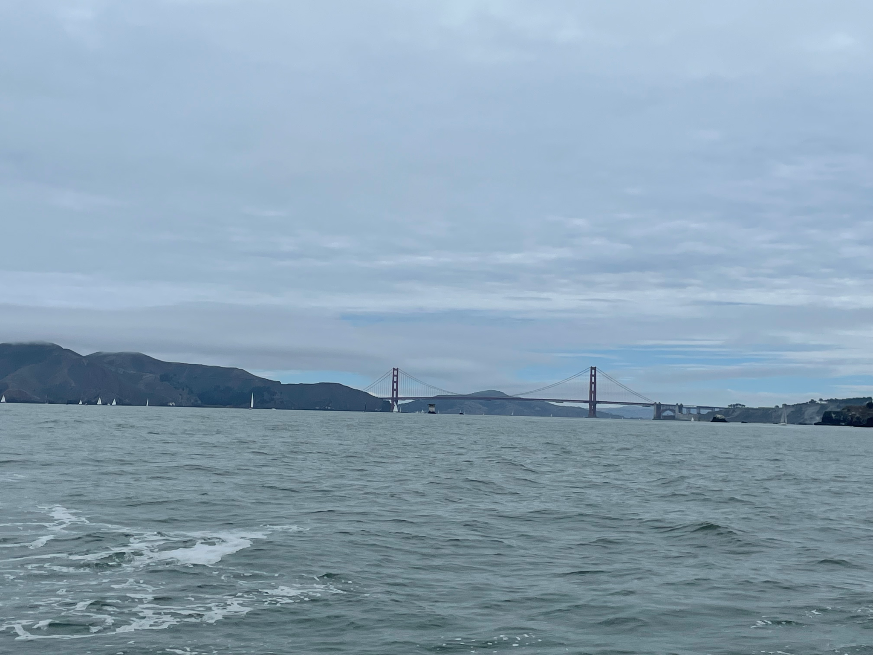
The Start
July 4, 2022
Light air
Might have been good for us due to experience on Lake Superior

Slide 34
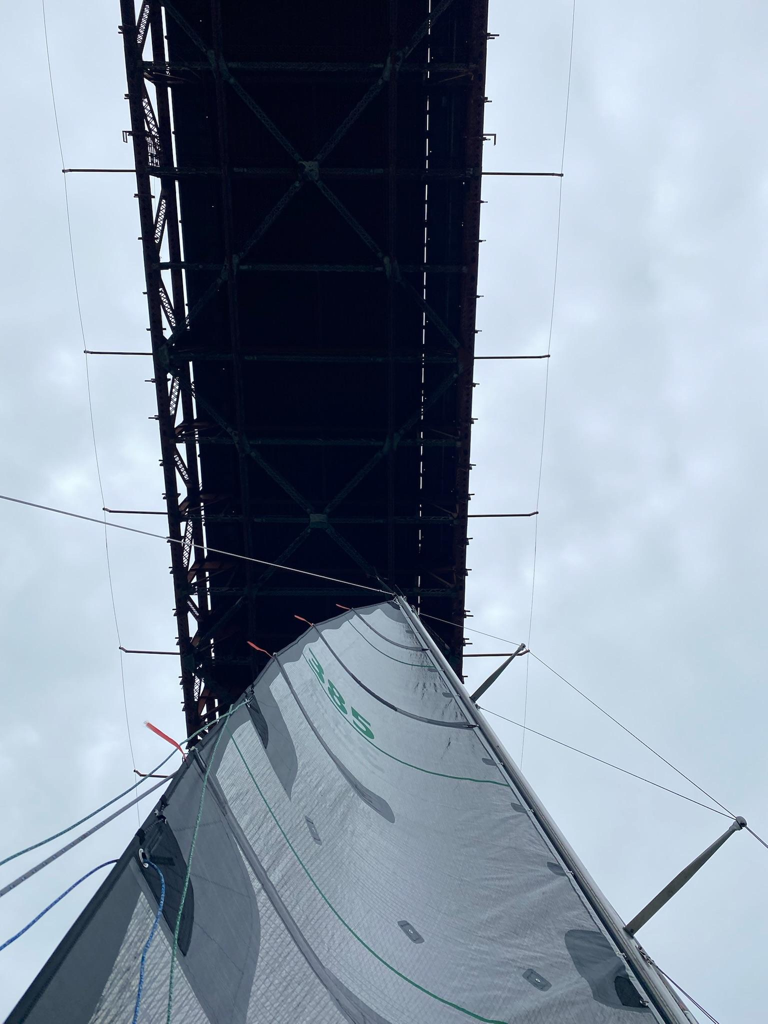

Slide 35
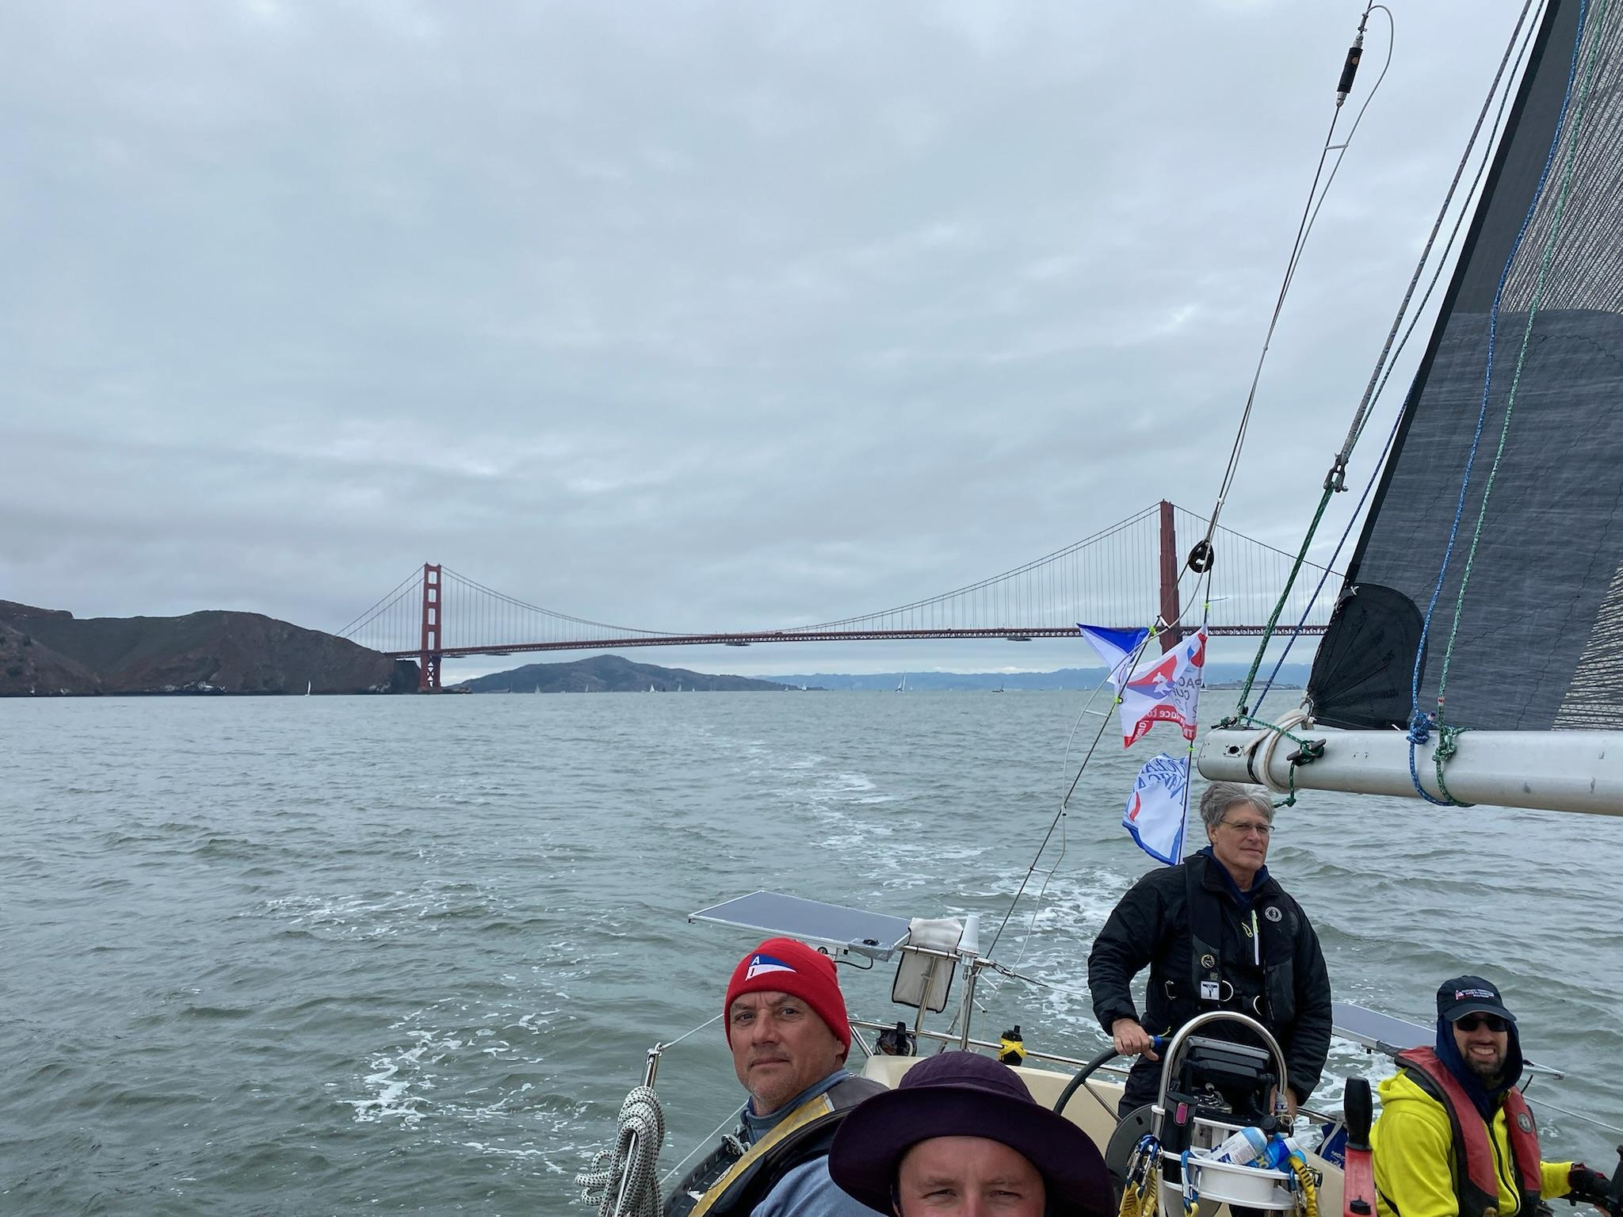

Slide 36
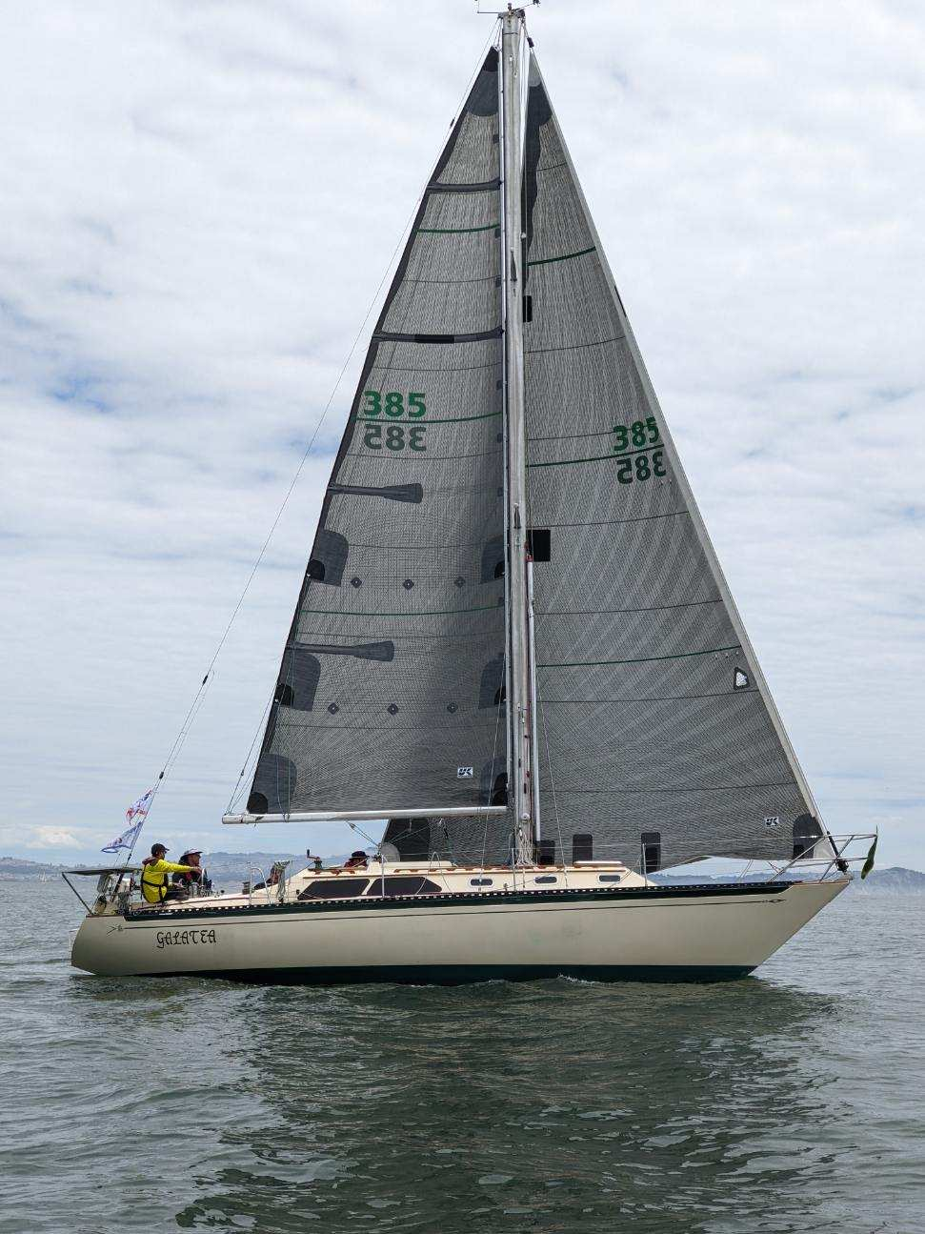

Slide 37
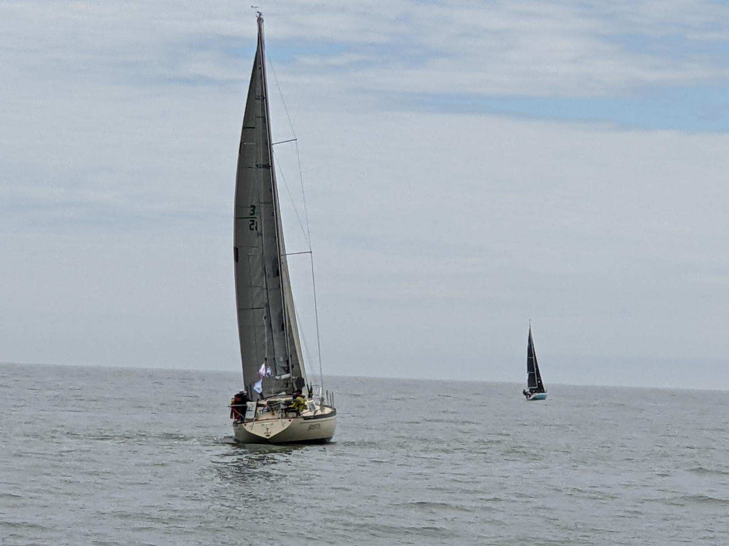

Slide 38
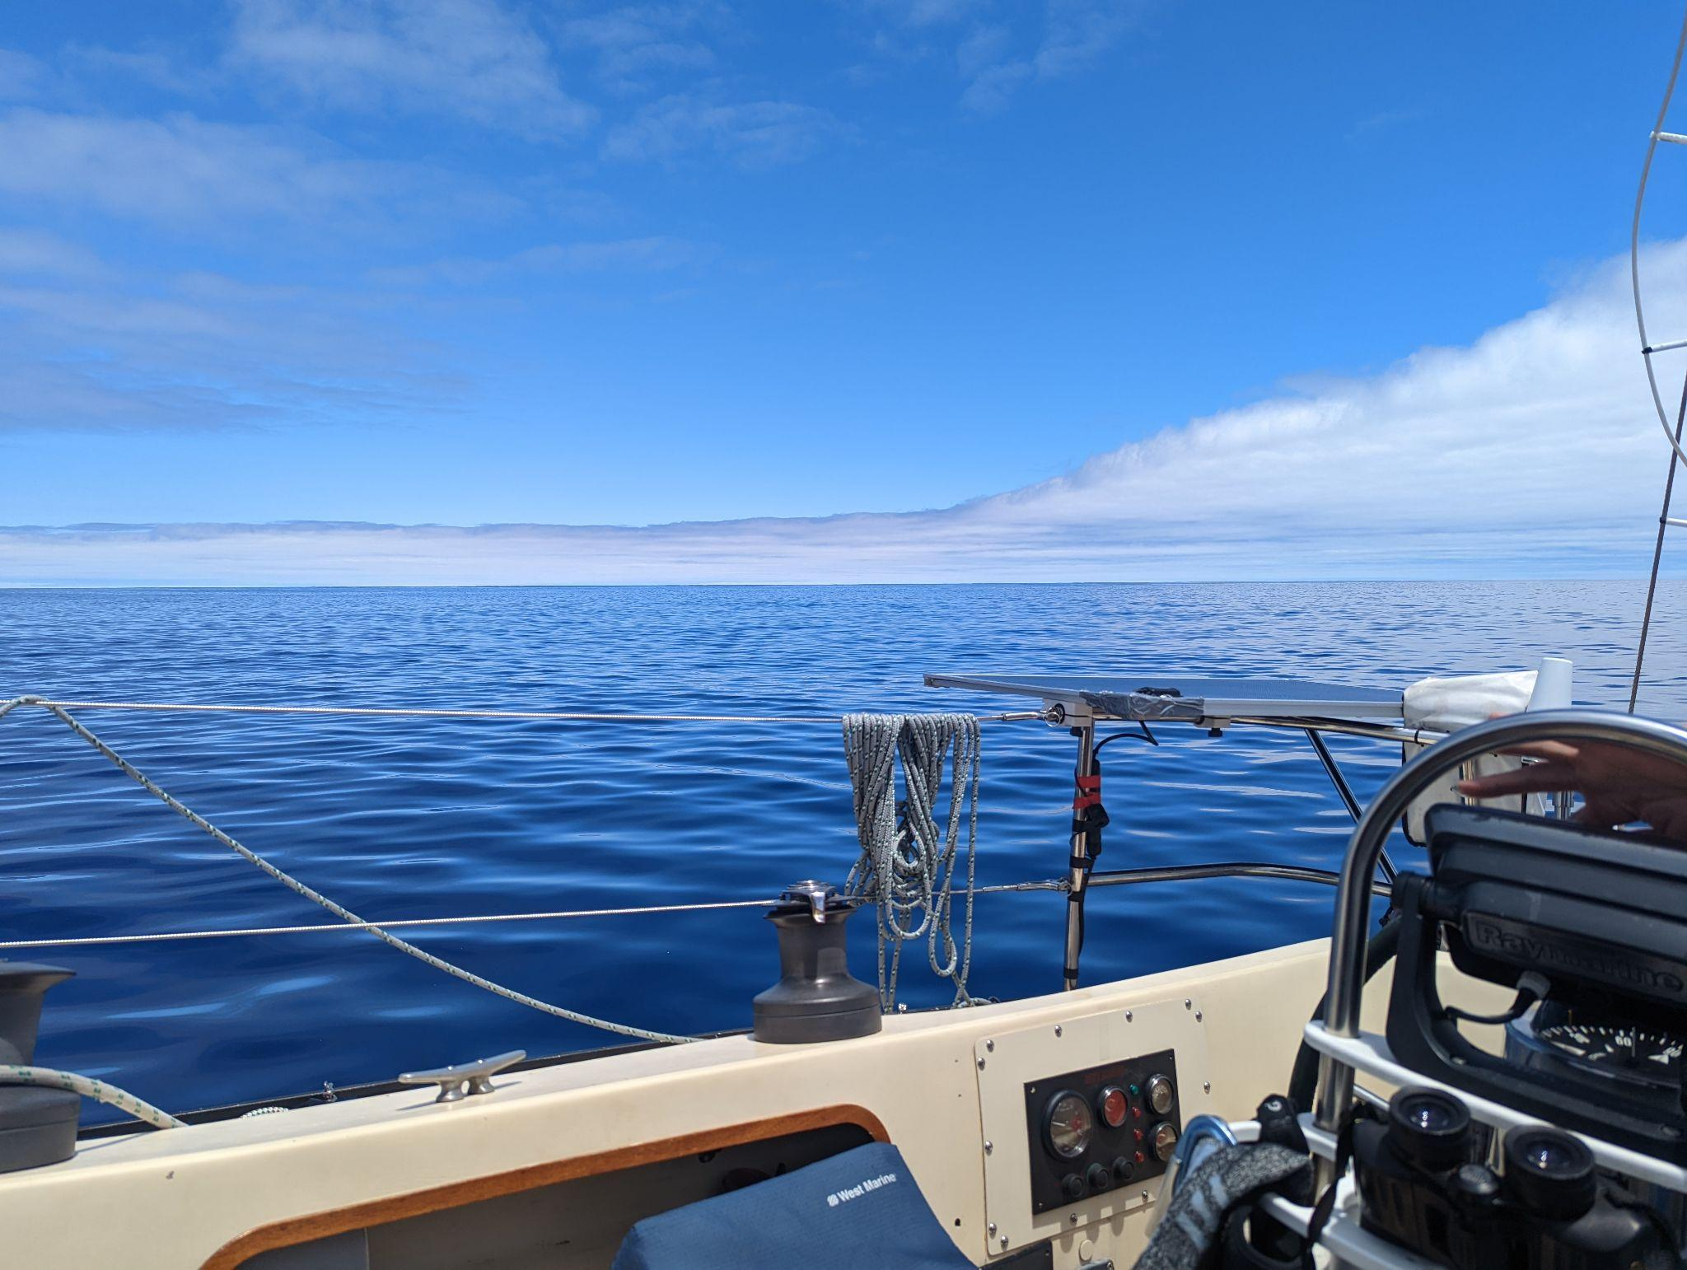
Light air for days
July 8, 4 days into the race
Averaging 85 nm/day
335 nm from Golden Gate
Yellow Brick ETA end of July
Going to take determination

Slide 39
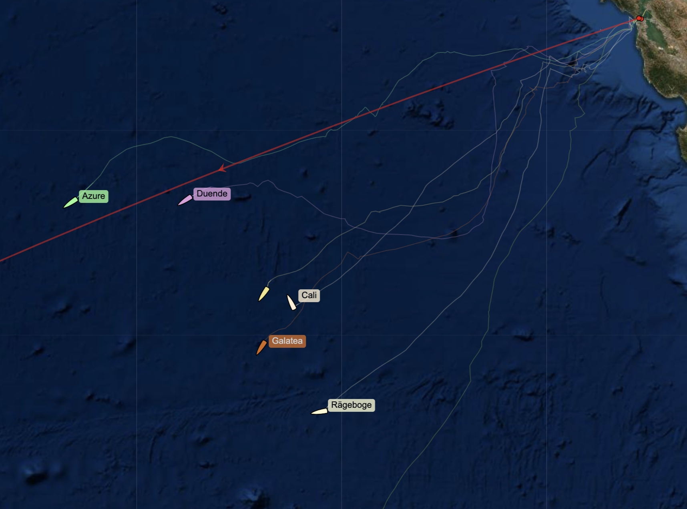
Position relative to the fleet at that point, July 8 mid-day

Slide 40
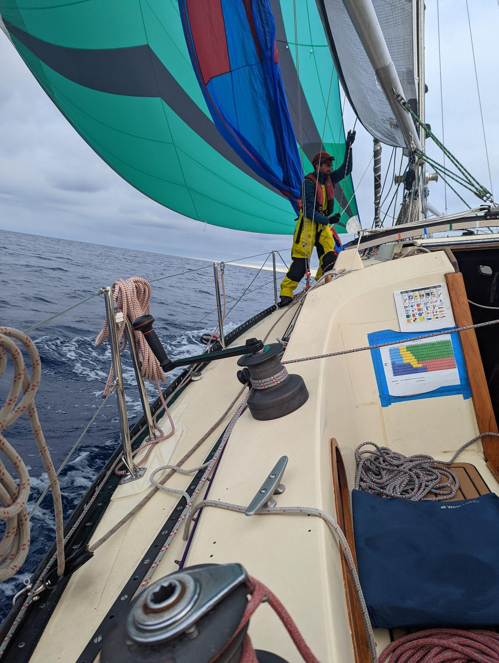
5th day, started to see wind one would typically expect during a Pac Cup
On starboard
Peeling A3 to A2
Unifying Mission: Get to the Luau

Slide 41
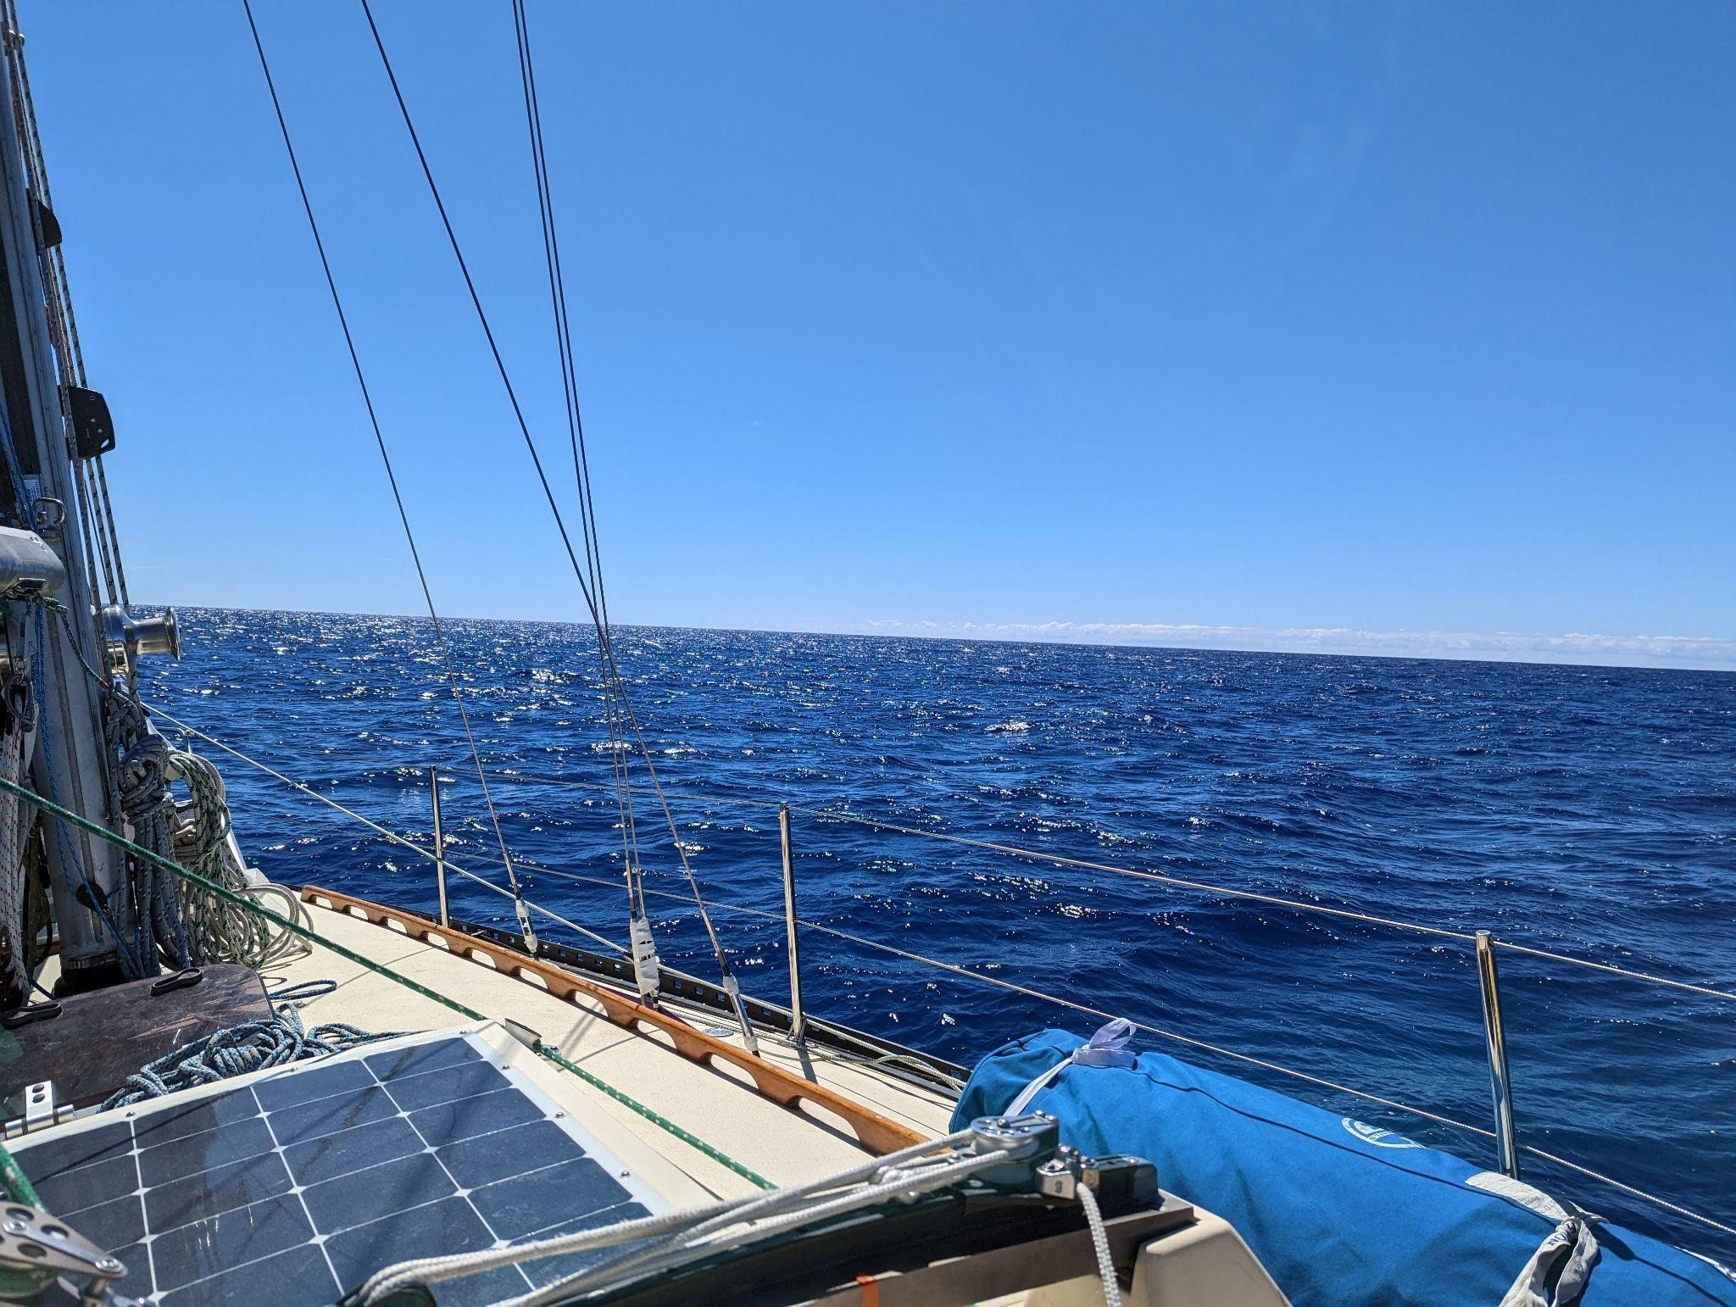

Slide 42
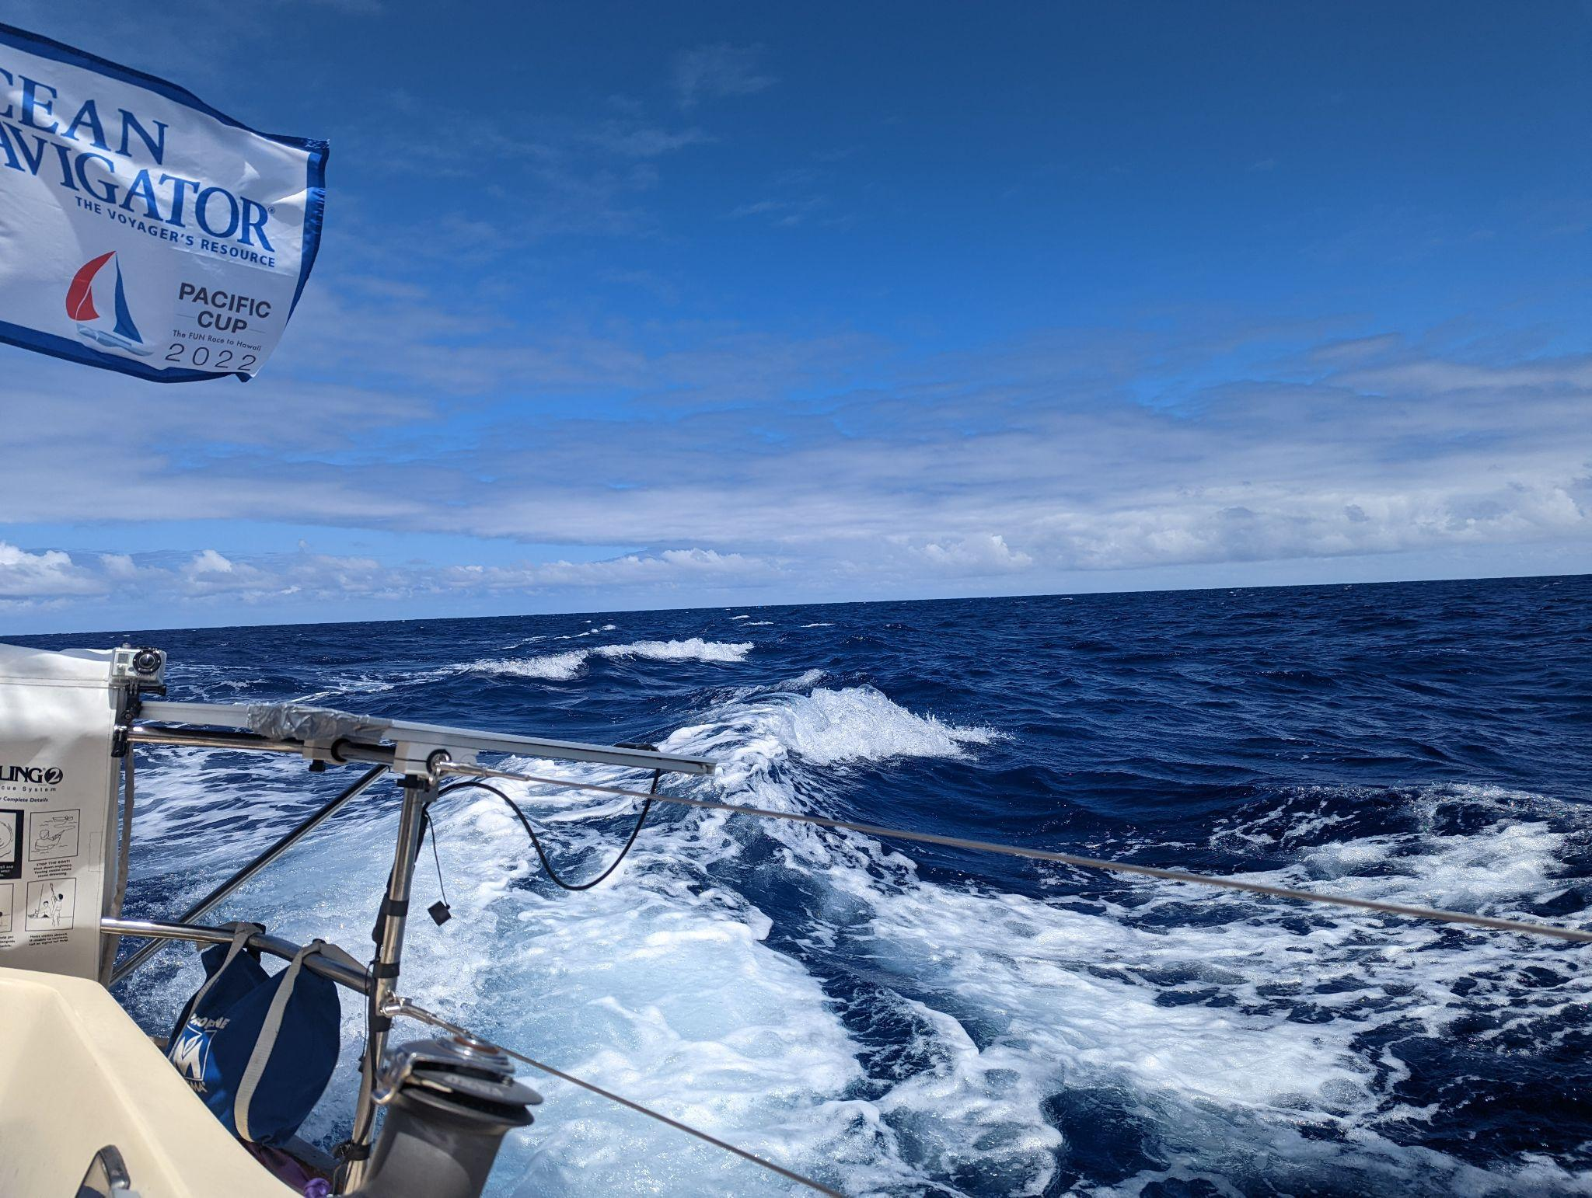

Slide 43
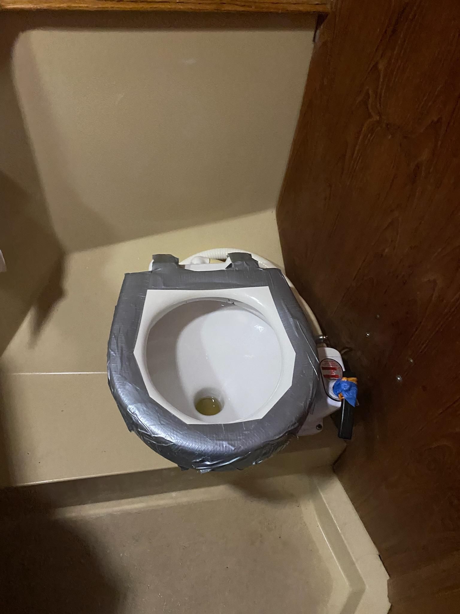
Things break
Toilet seat broke off
We lost some screws holding luff foil together
We had to re-run a frayed spin halyard

Slide 44
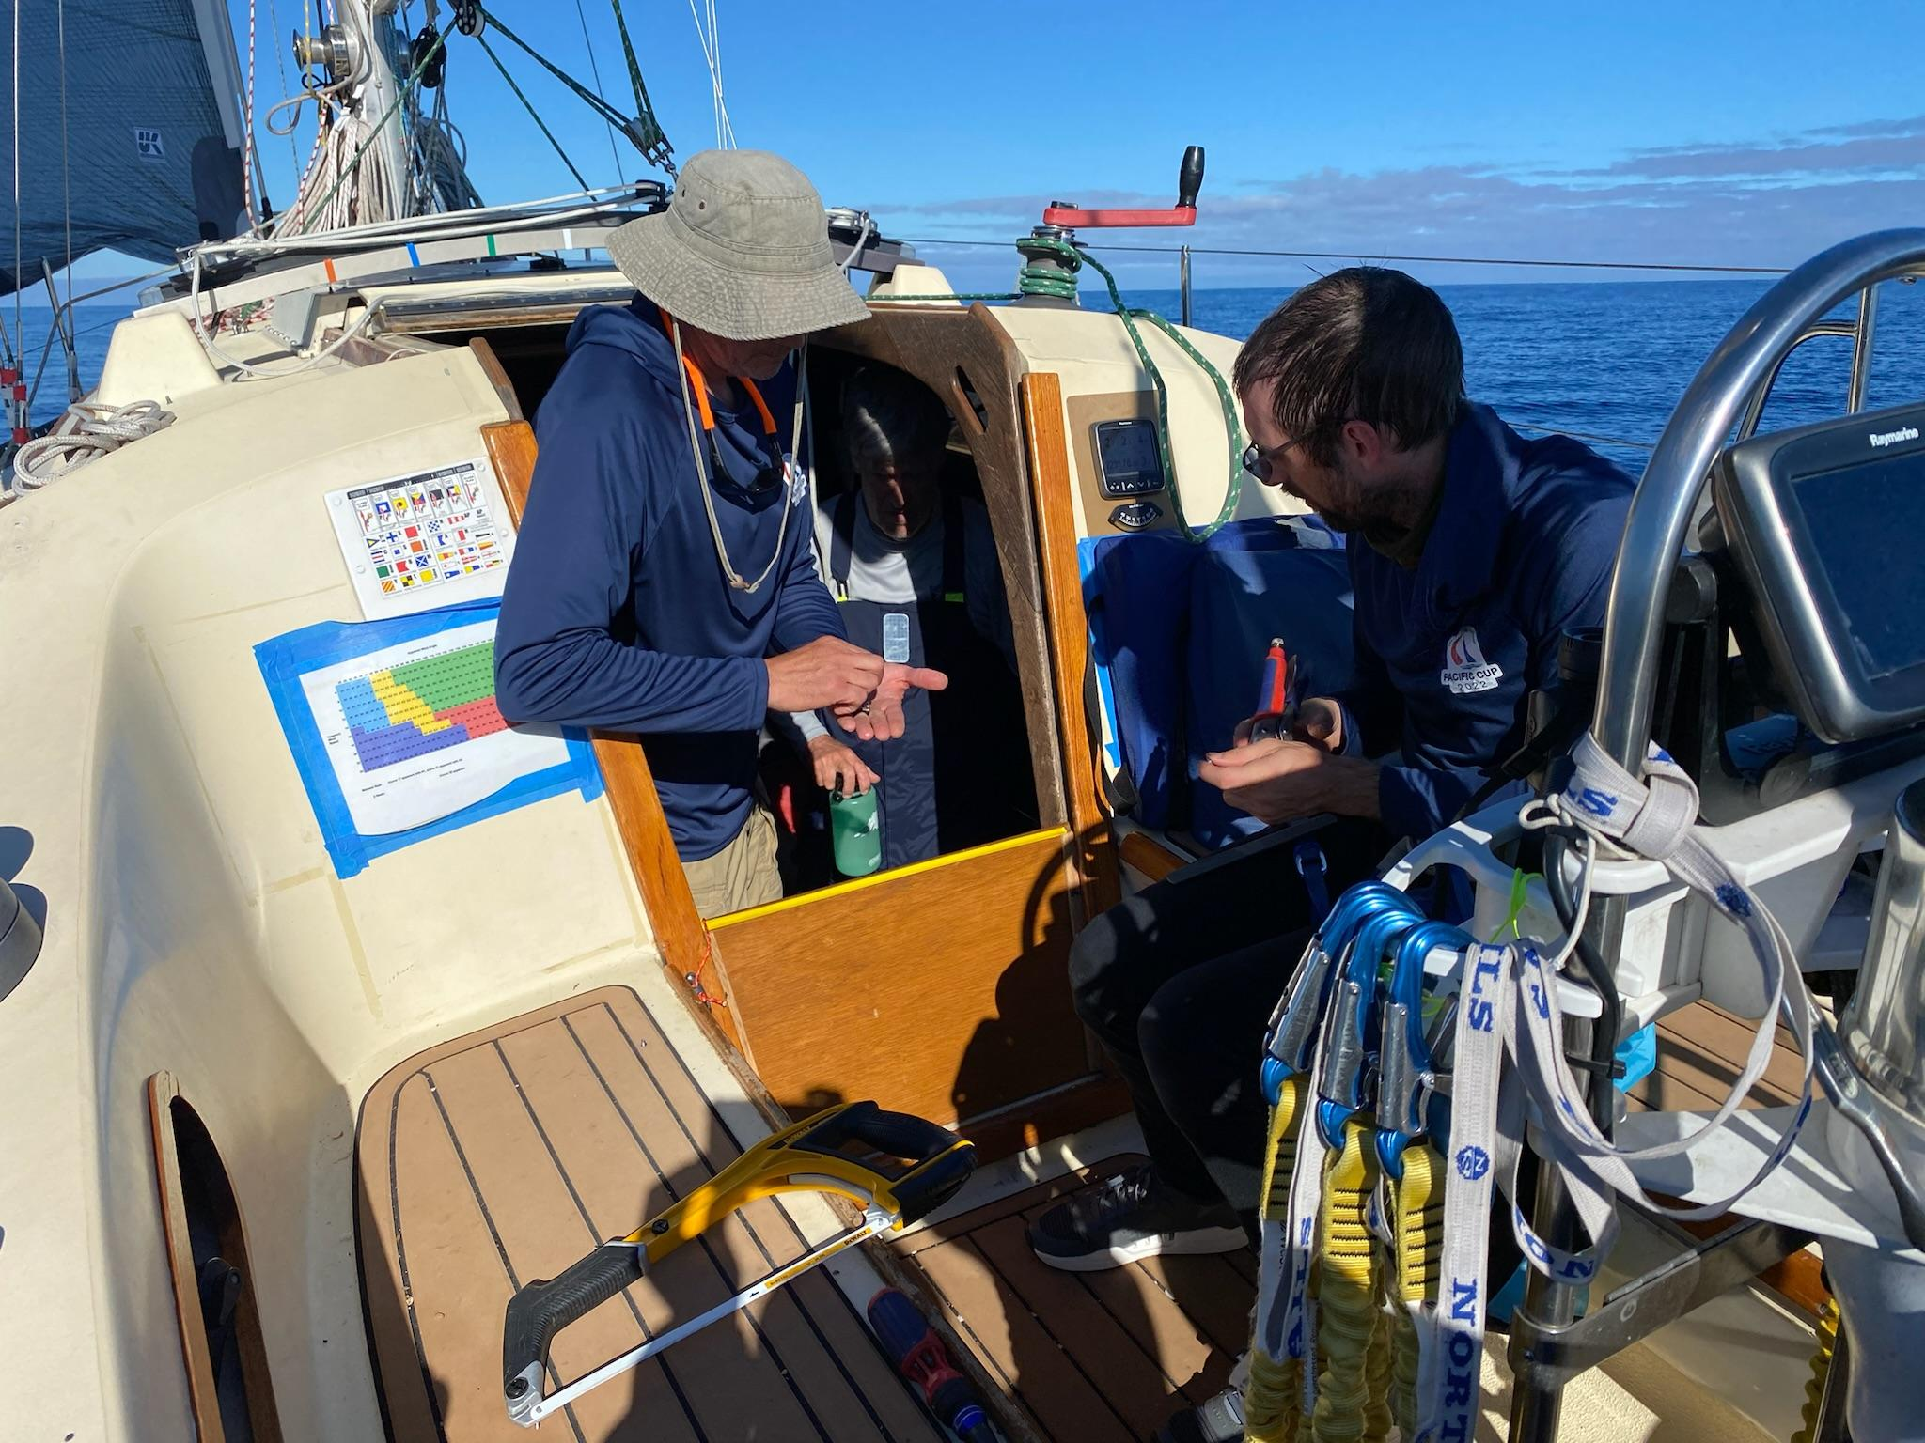

Slide 45
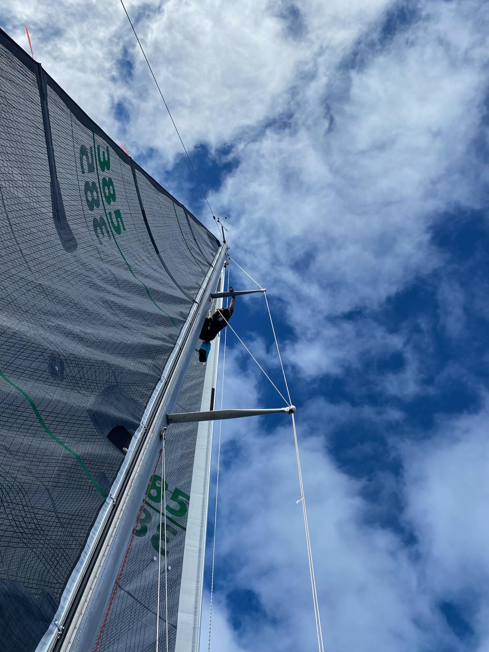

Slide 46
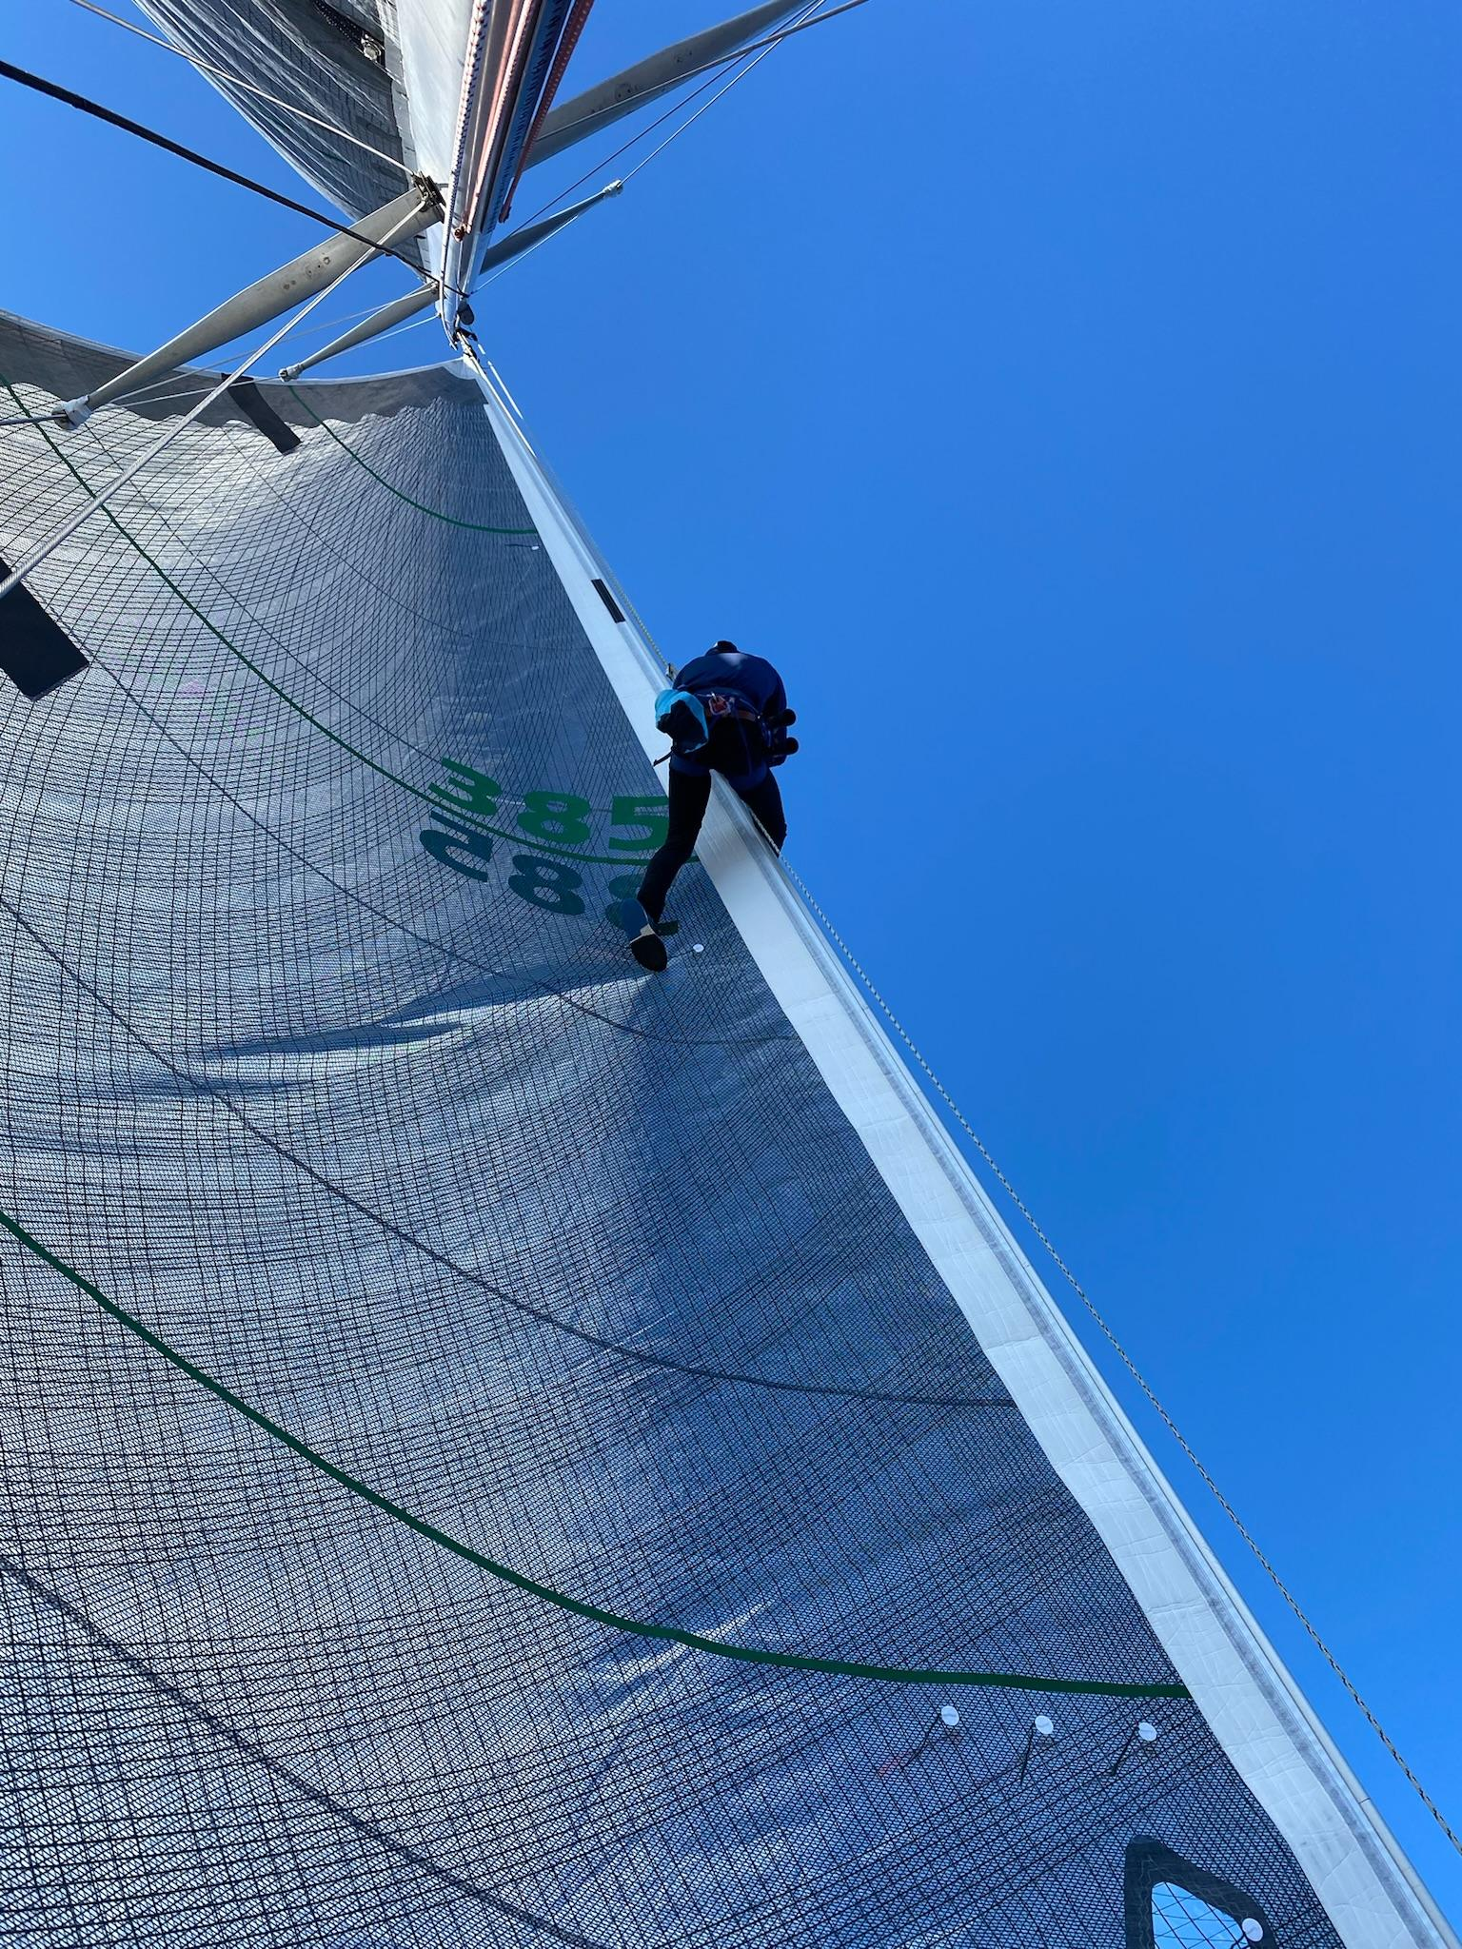

Slide 47
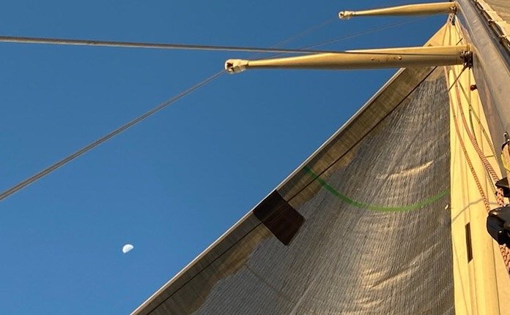

Slide 48
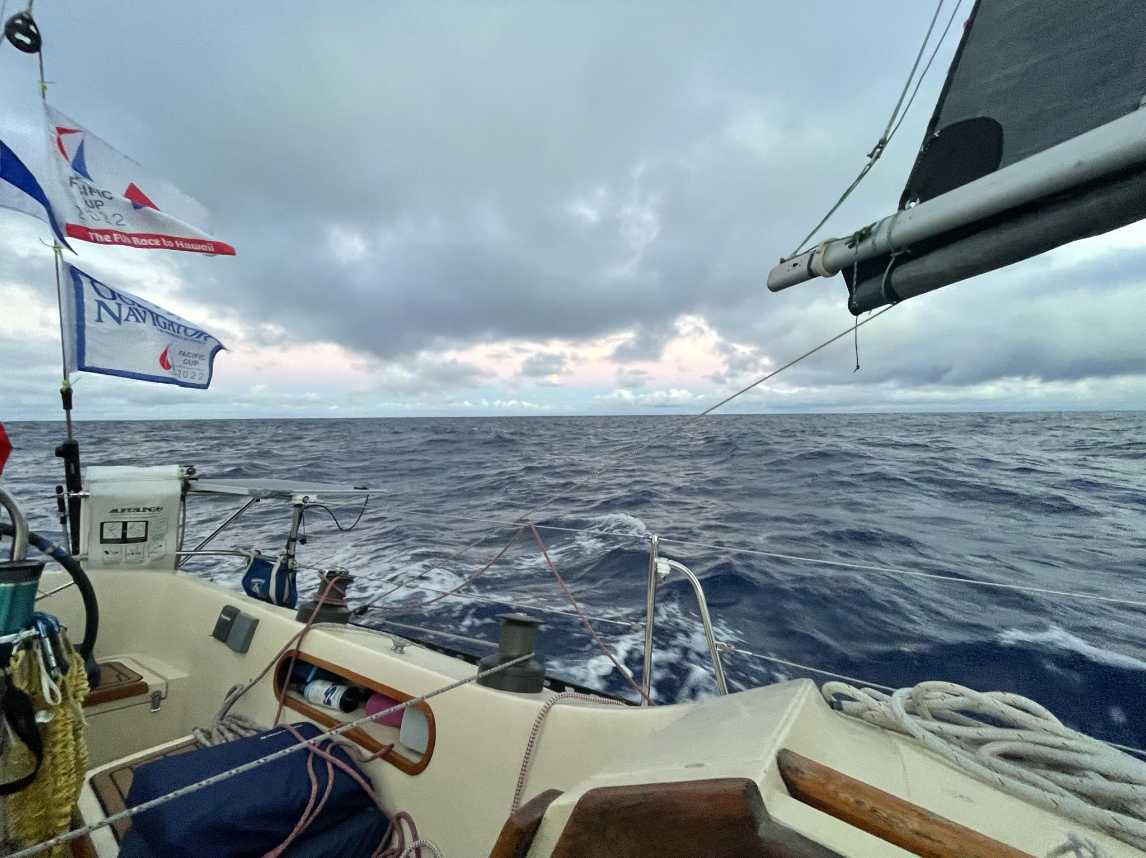

Slide 49
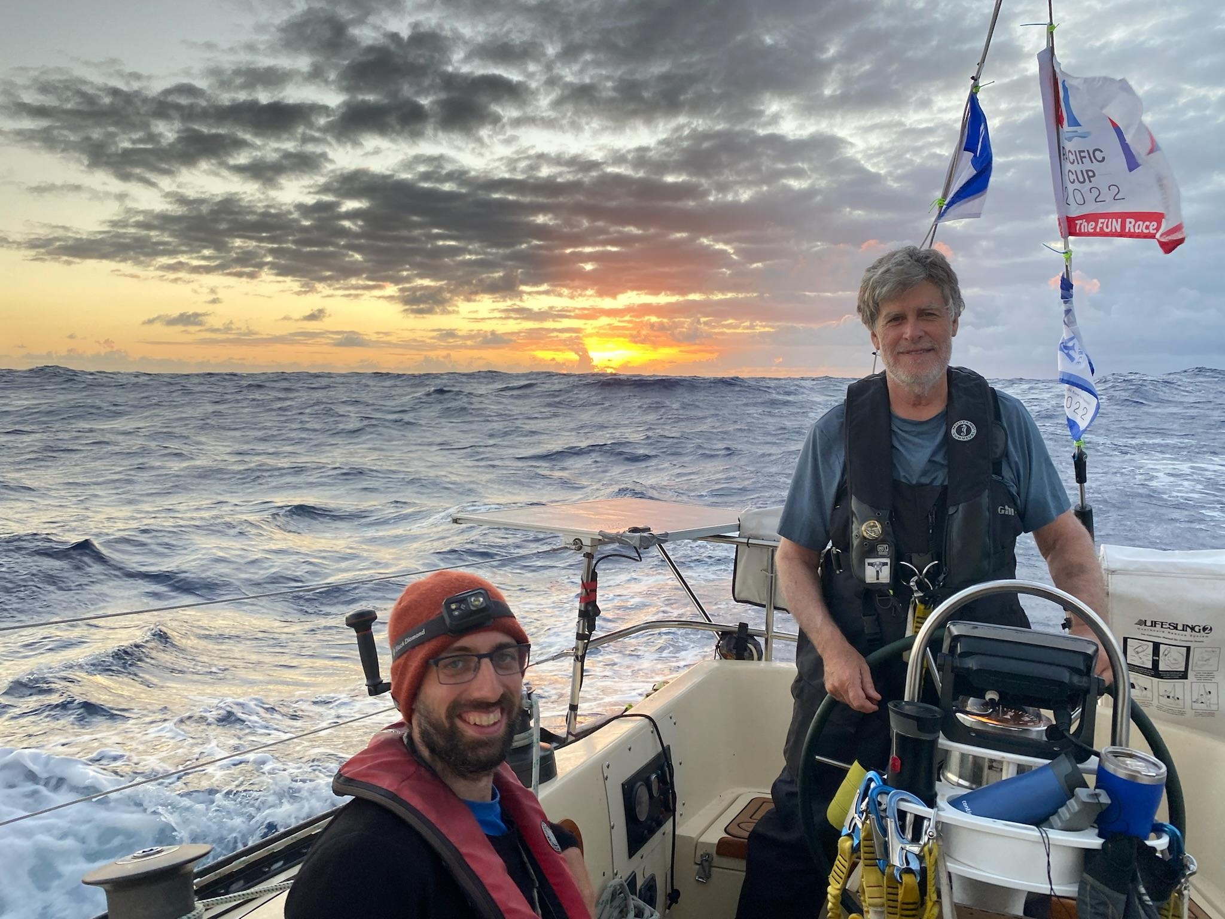

Slide 50
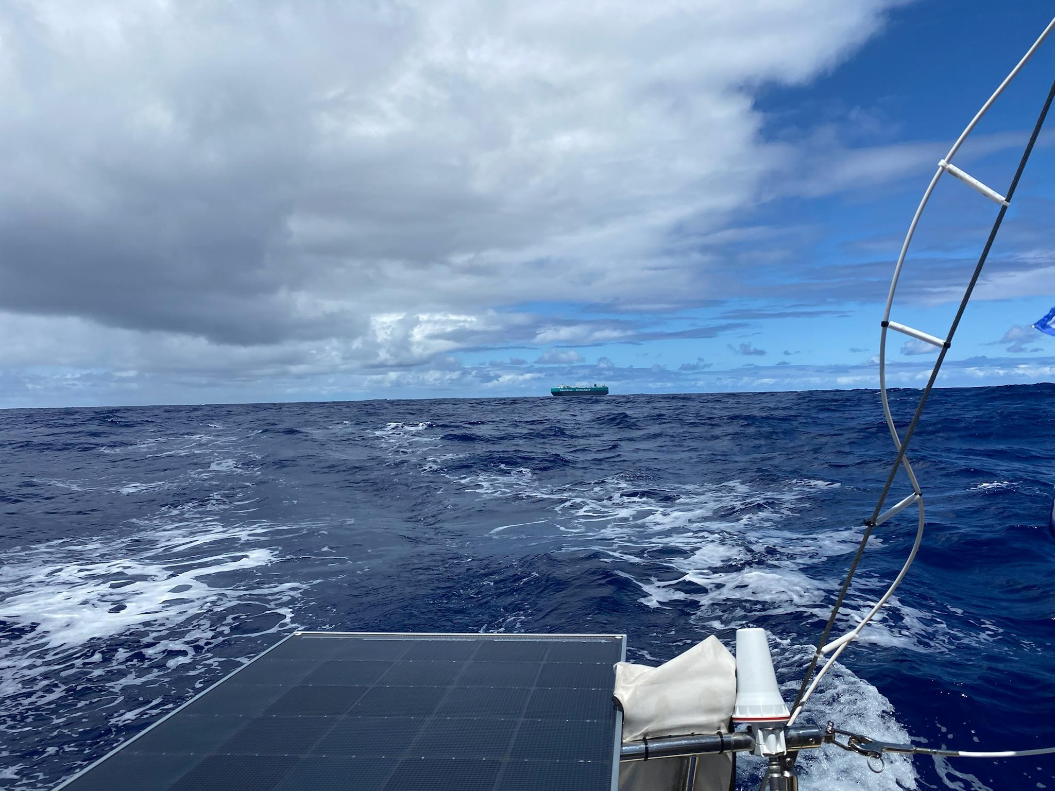
Freighters are parked 1000 nm from shore
We were hailed, captain worried

Slide 52
Watch Schedule
9 hours off for sleep
Remaining 15 hours
5 x 3 hour watches alternating
3 Primary
2 standby

Slide 54
Lots of flying fish
Flying squid
Nick got hit in the head by flying squid
Whales
Porpoises
Dolphins

Slide 55
Half Way!

Slide 56
July 14 950 nm from the finish
North had paid off
Commanders Weather had routed us south
La Niña year research conclusion was accurate

Slide 57
About 800 nm to go we spent a day moving south
To cover Alternate Reality.
To try for leverage against the Cal 40s
To get to the trades, wind and waves from Hurricane Darby

Slide 60
ThT
The tropics are hot
Need to be covered from the sun
No need to use a sleeping bag in the bunk

Slide 61
Masthead crane broke
Lot of wind from astern so we sailed under twin head sails
The intensity level dropped
I don’t think it impacted our position in the race

Slide 67
Finished late on July 19
15.5 days

Slide 69
Islander 36 in Pacific Cup
Subtle art sustained 9 knots in the trades
Spin halyards should stretch
Watermaker paid off
Structural improvements really paid off
Cal 40s are fast in races to HI
Probably need to get in front of them before trades
I did lots of I-36 routing over 12 prior years to understand overall game, ping me if interested

Slide 70
Time to have some fun
Families, partners, etc. came to HI
Rented a “compound” on Oahu with the Pearl crew
Pool time, sailing, beverages
Spent a week there

Slide 75
What’s next
Galatea is sold
New owners are cruisers in HI
I’m looking for another boat
Thank you!
Questions?

Slide 76
How do you sail a race from SF to HI?
None of us aboard Galatea had done this before
Task: understand the overall weather and strategy picture
Reanalysis GRIBS
Route historically with I-36 polars based on reanalysis
Not a forecast, what NOAA thinks actually happened informed by observations

Slide 78
What was expected:
South of rhumb line. Starboard until you gybe.
Like 2012

Slide 79
What might happen:
Dispersed tracks
Like 2011

Slide 80
North of the rhumb line, like 2010, a La Niña year.
To be continued..

Slide 81
Pearl
Eric Thomas
Jon Haaversen
Justin Aulie
Allen Thomas

