Slide 1

Fall Meeting
11/16/2024
Welcome
Rick Egan Commodore
50 Years of the Association

Slide 2
Agenda
Welcome
Introduce Officers
  Thank you to Steve and Jocelyn for long service and hosting us at CPYC
Trophy Updates Big Shout Out to Rick VM, Kit W. Roy Samuelson
Guest Speaker Kit Weigman (his journey in a well used Islander)
Membership and Finance Update_ Mike Patterson
Elect Officers
Membership survey preliminary results_ Rick Egan
Awards !!!

Slide 3
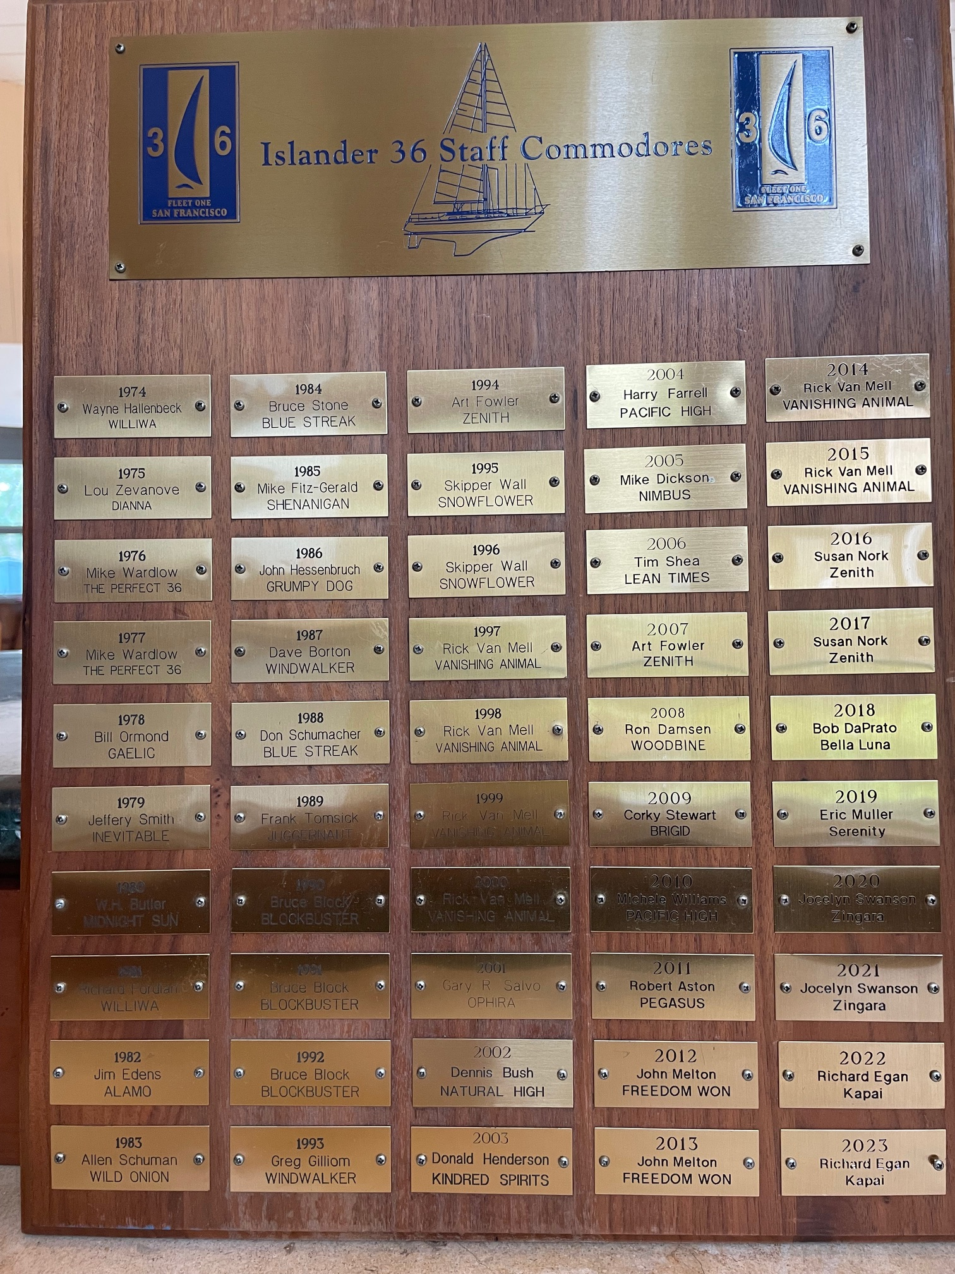
50 Years – Plaque Running out of Room!

Slide 4
Agenda
Welcome
Introduce Officers
  Thank you to Steve and Jocelyn for long service and hosting us at CPYC
Trophy Updates Big Shout Out to Rick VM, Kit W. Roy Samuelson
Guest Speaker Kit Weigman (his journey in a well used Islander)
Membership and Finance Update_ Mike Patterson
Membership survey preliminary results_ Rick Egan
Awards !!!

Slide 5
I 36 Membership Survey
Members Afar responses
81% Primarily cruise
Would like to meet others in their area. ( we can facilitate)
93% would join an annual or Bi- annual ZooM with a specific topic of interest.i.e. maintenance
  Good opportunity to build community

Slide 6
I 36 Membership Survey
22 Responses Evenly Split Norcal/Remote
Norcal
Meetings
  25% attend meetings
  60% would like to sail to meeting
  Favorite locations Richmond, Encinal and split between GGYC and SF YC

Slide 7
I 36 Membership Survey
Norcal Cruising Responses
Favorite Cruising Venues
  Angel Island, Round Alameda, SouthBeach +Giants, Sailstice + McCovey and Petaluma on Memorial Day
50% would join cruising division of destination races like Vallejo
66% in favor of kid friendly cruises
66% in favor of joining ZooM to plan cruises
55% favor investigation into merging cruises. 44% said maybe.???

Slide 8
I 36 Membership Survey
Norcal Racing Responses
10 Responses ( small sample size)
  4 with no interest
Lack of crew most cited as reason to not race
  We should try to get some cruisers to crew
Spinnaker and Non Spinnaker equally split
Favorite Venues
  Great Vallejo, Jazz, Encinal Pt. Bonita ( could be oppty for cruise division participation)
  Majority would jump on ZooM to plan

Slide 9
I 36 Membership Survey
Members Afar responses
81% Primarily cruise
Would like to meet others in their area. ( we can facilitate)
93% would join an annual or Bi- annual ZooM with a specific topic of interest.i.e. maintenance
  Good opportunity to build community

Slide 10
I 36 Membership Survey
All members question
What do you value most in the Association?
Website 4.6 stars (a suggestion to archive on FB) Newsletter 4.6 stars
Pose a question to the fleet. 4.6 stars
PICYA 3.6 stars
In the freeform response, comments regarding the Association were quite favorable
Thanks to all that participated. We will let you know what specific actions we will take.

